Slide 1
EMBC Workshop: Model-Based Design for Cardiovascular Monitoring Devices: Examples Using Oscillometric and Continuous Blood Pressure Methods
Miodrag Bolic
Professor, Director of Computer Engineering Program
School of Electrical Engineering and Computer Science
University of Ottawa
mbolic@uottawa.ca
July 15, 2024
EMBC, Orlando

Slide 2
Outline
Introduction (10 min)
Part 1: Errors and uncertainty quantification (30 min)
Definitions of errors and agreement
Uncertainty quantification
Part 2: Uncertainty propagation and sensitivity analysis (45 min)
Workflow that includes model, parameter estimation, uncertainty propagation and sensitivity analysis
Uncertainty propagation based on perturbation and Monte Carlo sampling
Part 3: Modeling biomedical systems (60 min)
Modeling signal generation, noise and assessing signal quality
Part 4: Uncertainty propagation/sensitivity analysis through more complex models (45 min)
Modeling continuous blood pressure devices
Modeling oscillometric algorithms
Part 5: Conclusion (10 min)

Slide 3




Ottawa, Canada

Slide 4
About myself
Professor at the University of Ottawa for 20 years
Associate Director of the undergraduate Computer Engineering program
Interim Director of graduate Applied AI program.
Research Director of the Computational Analysis and Acceleration Research Group and the Health Devices Research Group.
Worked on cardiorespiratory monitoring for the last 15 years
design of devices
development of signal processing/machine learning algorithms.
Currently supervise 2 postdoctoral fellows, 10 graduate students and 5 summer students

Slide 5
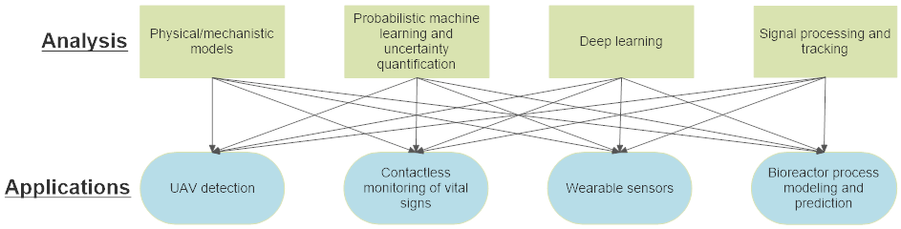
UOttawa Computational Analysis and Acceleration Research Group (CARG)

Slide 6
CARG’s current or recently completed biomedical projects

Slide 7
Why model-based design?
Model-based engineering can be defined as Hart (2015): “An approach to engineering that uses models as an integral part of the technical baseline that includes the requirements, analysis, design, implementation, and verification of a capability, system, and/or product throughout the acquisition life cycle.”
We will model
hardware
algorithms of the device
the interface between the sensor and the patient.
Modeling all of these will allow us to analyze how different parameters of the system affect the accuracy and precision of the device.

Slide 8
What is a model and what is simulation?
A model is a representation of a system, phenomenon or process using mathematical concepts.
The purpose of modeling is to represent the system and its components to evaluate its behavior when subjected to certain inputs and for different values of model parameters.
The simulation is the examination of the model or the problem by using a computer program without direct experimentation.
The simulation starts when the computer program is executed, and the output of the model is calculated for the given inputs, parameters and conditions. Simulations allow us to determine or predict the behavior of the system under different conditions.

Slide 9
What are challenges in running experiments in the biomedical field?
Running studies on human subjects takes long time and requires obtaining Ethics approval, agreement of the patients, collaboration and interest of the medical personnel taking care of the patients and so on.
The outcomes of the studies need to be evaluated and labeled by an expert, which is very expensive.
Some situations and conditions are very difficult to observe and happen rarely. An extreme example is syncope or losing consciousness.
Patients are different, and we often do not know why some patients react in different ways to the same stimulus.
True reference value might be unknown, and therefore, it is not easy to estimate the accuracy of a device. An example: blood pressure measurements.

Slide 10
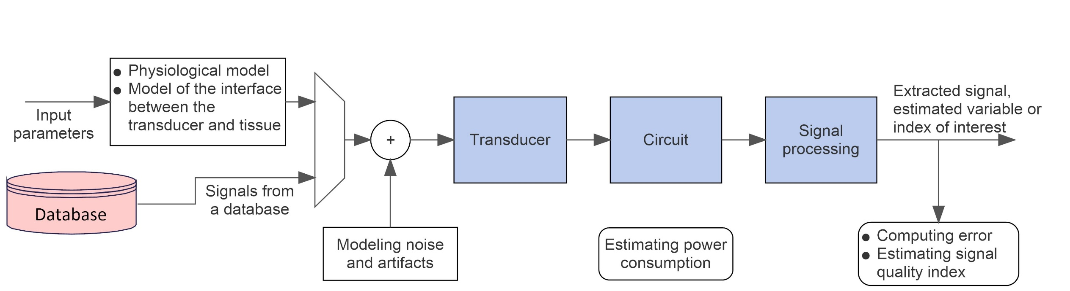
What is a general model of a biomedical system?
Confidence interval
Sensitivity to different parameters

Slide 11
About this workshop
Professionals and researchers interested in quantifying uncertainties in complex systems.
Workshop Objectives:
End-to-End System Modeling:
Explore the unique approach of end-to-end models, encompassing the transducer-human body interface, circuits, and signal processing algorithms.
Understand how physiological parameters and design choices impact device performance.
2. Hands-On Simulation:
Demonstrate the use of basic Matlab®/Simulink® functionalities to explore system behavior.
Provide participants with hands-on experience by sharing relevant code for simulation.
3. Introduction to Uncertainty Quantification and Sensitivity Analysis:
Understand how to evaluate different design choices through uncertainty quantification and sensitivity analysis.
Discuss the crucial role of these analyses in designing robust and reliable monitoring devices.

Slide 12
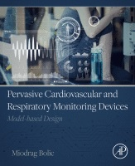
Resources for this workshop
Book: Pervasive Cardiovascular and Respiratory monitoring devices: Model-based Design
Simulation and modeling of biomedical devices
Uncertainty quantification and sensitivity analysis
Resources for this tutorial
https://github.com/Health-Devices/EMBC_Bolic
Matlab Online only for several days after the tutorial: https://www.mathworks.com/licensecenter/classroom/4469902/
Book resources:
To download all Matlab code and Simscape models, please go to Book GitHub Site.
To see HTML version of the code, please go to Book's HTML Matlab Live Editor Files.

Slide 13
Outline
Introduction (10 min)
Part 1: Errors and uncertainty quantification (30 min)
Definitions of errors and agreement
Uncertainty quantification
Part 2: Uncertainty propagation and sensitivity analysis (45 min)
Workflow that includes model, parameter estimation, uncertainty propagation and sensitivity analysis
Uncertainty propagation based on perturbation and Monte Carlo sampling
Part 3: Modeling biomedical systems (60 min)
Modeling signal generation, noise and assessing signal quality
Part 4: Uncertainty propagation/sensitivity analysis through more complex models (45 min)
Modeling continuous blood pressure devices
Modeling oscillometric algorithms
Part 5: Conclusion (10 min)

Slide 14
Questions that we will try to address
Part 1
What is error?
What is accuracy and precision?
What is agreement in paired measurements?
How can we quantify uncertainty?
Confidence intervals
Part 2
What is uncertainty propagation?
What is sensitivity analysis and how is it different from uncertainty quantification?

Slide 15
What is uncertainty quantification?
It is a science of quantitative characterization and estimation of uncertainties in both computational and real-world applications
Sources of uncertainty:
noise in data,
model parameters,
lack of knowledge about the physics of the problem,
algorithmic (approximate solutions, numeric accuracy)
Measurement uncertainty is the expression of statistical dispersion of the values attributed to the measurand.
Measurement result is complete only when it is accompanied by an associated statement about the uncertainty
Indirect measurements: there is a function or a model that converts a quantity value into the corresponding value of the measurand.

Slide 16
What is the difference between measurement error and uncertainty?
All measurements have errors
the limited accuracy of measurement instruments,
the exceedingly high cost of performing accurate experiments and/or measurements,
the lack of accurate models or the computational need of using simplified ones.
An error e = measured value– “true” value
An uncertainty u is an estimate of an interval ±u that should contain an error.
Uncertainty quantification allows us to provide estimates of the quantity of interest that are not just single numbers (point estimates) but provide confidence intervals or some other statistical measure

Slide 17
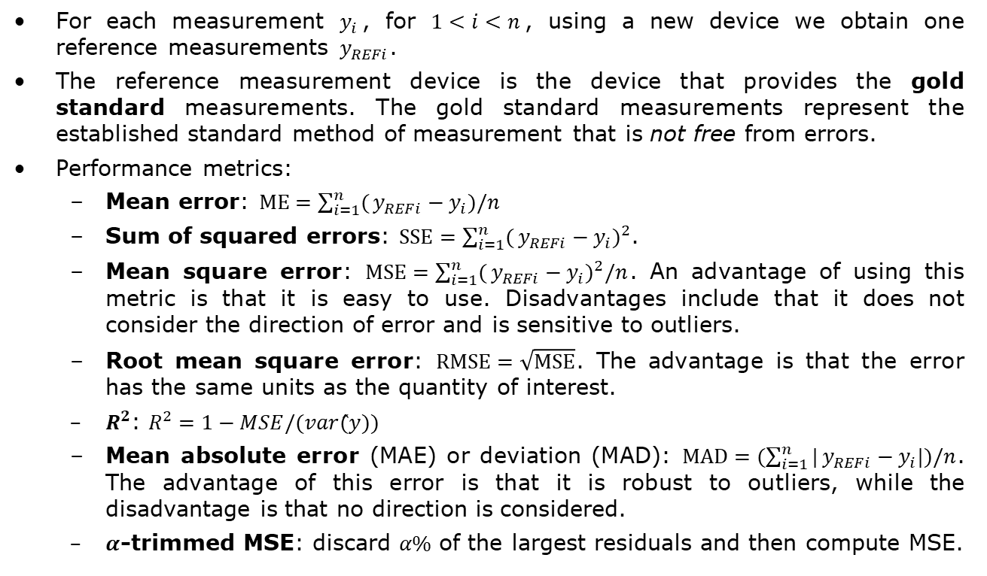
How can we express errors in paired measurements?
For each measurement $y_{i}$, for $1<i<n$, using a new device we obtain one reference measurements $y_{REFi}$.
The reference measurement device is the device that provides the gold standard measurements. The gold standard measurements represent the established standard method of measurement that is not free from errors.
Performance metrics:
Mean error: $ME=\sum_{i=1}^{n}{(}y_{REFi}−y_{i})/n$
Sum of squared errors: $SSE=\sum_{i=1}^{n}{(}y_{REFi}−y_{i})^{2}$.
Mean square error: $MSE=\sum_{i=1}^{n}{(}y_{REFi}−y_{i})^{2}/n$. An advantage of using this metric is that it is easy to use. Disadvantages include that it does not consider the direction of error and is sensitive to outliers.
Root mean square error: $RMSE=\sqrt{MSE}$. The advantage is that the error has the same units as the quantity of interest.
$R^{2}$: $R^{2}=1−MSE/(var(̂y))$
Mean absolute error (MAE) or deviation (MAD): $MAD=(\sum_{i=1}^{n}{|}y_{REFi}−y_{i}|)/n$. The advantage of this error is that it is robust to outliers, while the disadvantage is that no direction is considered.
$α$-trimmed MSE: discard $α\%$ of the largest residuals and then compute MSE.

Slide 18
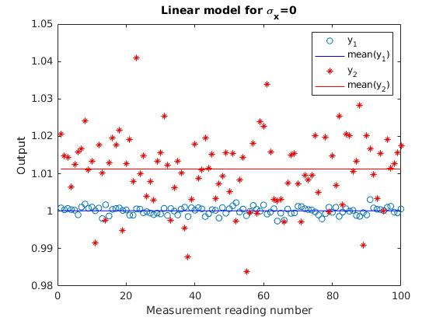
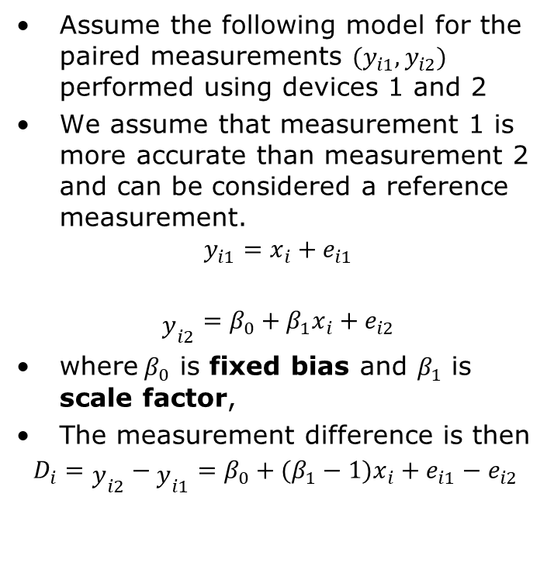
How can we model paired measurement for 2 different devices?
Assume the following model for the paired measurements ${(y}_{i1},y_{i2})$ performed using devices 1 and 2
We assume that measurement 1 is more accurate than measurement 2 and can be considered a reference measurement.
$$y_{i1}=x_{i}+e_{i1}$$
$${\begin{aligned} \\ y\end{aligned}}_{i2}=β_{0}+β_{1}x_{i}+e_{i2}$$
where$β_{0}$ is fixed bias and $β_{1}$ is scale factor,
The measurement difference is then
$$D_{i}={{\begin{aligned} \\ y\end{aligned}}_{i2}−{\begin{aligned} \\ y\end{aligned}}_{i1}=β}_{0}+(β_{1}−1)x_{i}+e_{i1}−e_{i2}$$
To run the program, go to EMBC Matlab\Part 1\accuracy.mlx

Slide 19
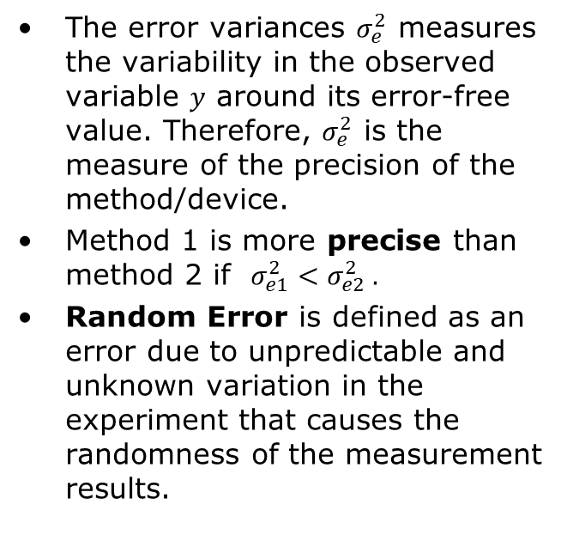
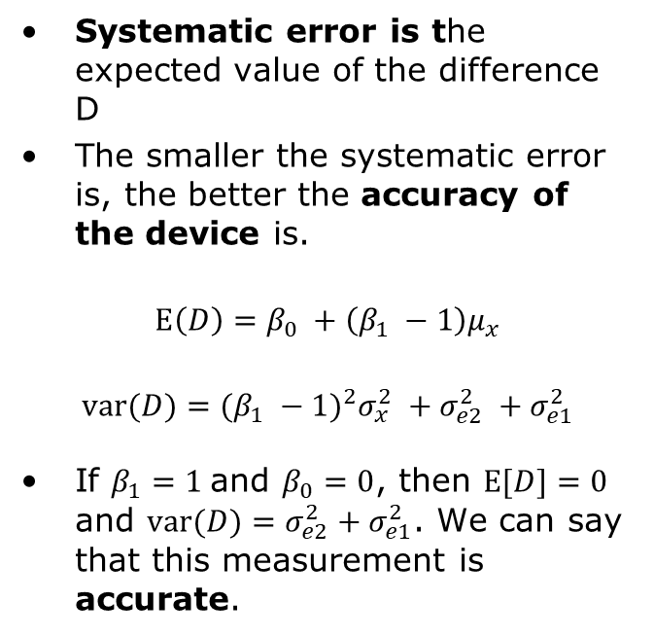
What is the precision and accuracy based on our model?
Precision
Accuracy
The error variances $σ_{e}^{2}$ measures the variability in the observed variable $y$ around its error-free value. Therefore, $σ_{e}^{2}$ is the measure of the precision of the method/device.
Method 1 is more precise than method 2 if ${σ_{e1}^{2}<σ}_{e2}^{2} .$
Random Error is defined as an error due to unpredictable and unknown variation in the experiment that causes the randomness of the measurement results.
Systematic error is the expected value of the difference D
The smaller the systematic error is, the better the accuracy of the device is.
$$E\left(D\right)=β_{0}+\left(β_{1}−1\right)μ_{x}$$
$$var(D)=(β_{1}−1)^{2}σ_{x}^{2}+σ_{e2}^{2}+σ_{e1}^{2}$$
If $β_{1}=1$and $β_{0}=0$, then $E[D]=0$ and $var(D)=σ_{e2}^{2}+σ_{e1}^{2}$. We can say that this measurement is accurate.

Slide 20
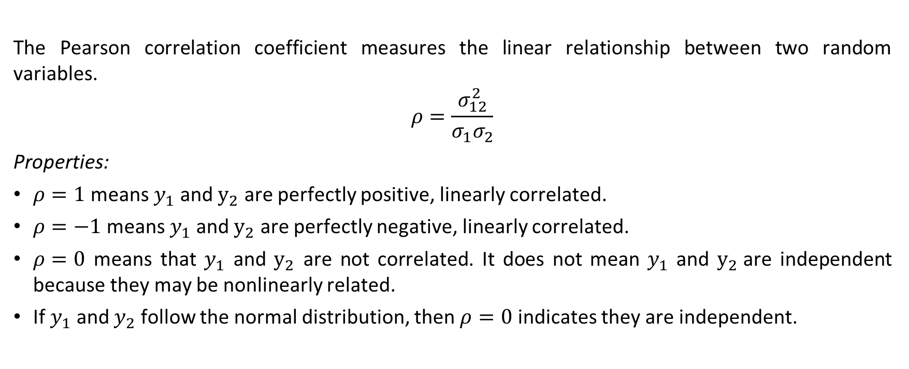
How can we interpret Pearson correlation coefficient?
The Pearson correlation coefficient measures the linear relationship between two random variables.
$$\begin{matrix}ρ=\frac{σ_{12}^{2}}{σ_{1}σ_{2}}\end{matrix}$$
Properties:
$ρ=1$ means $y_{1}$ and $y_{2}$ are perfectly positive, linearly correlated.
$ρ=−1$ means $y_{1}$ and $y_{2}$ are perfectly negative, linearly correlated.
$ρ=0$ means that $y_{1}$ and $y_{2}$ are not correlated. It does not mean $y_{1}$ and $y_{2}$are independent because they may be nonlinearly related.
If $y_{1}$ and $y_{2}$ follow the normal distribution, then $ρ=0$ indicates they are independent.

Slide 21
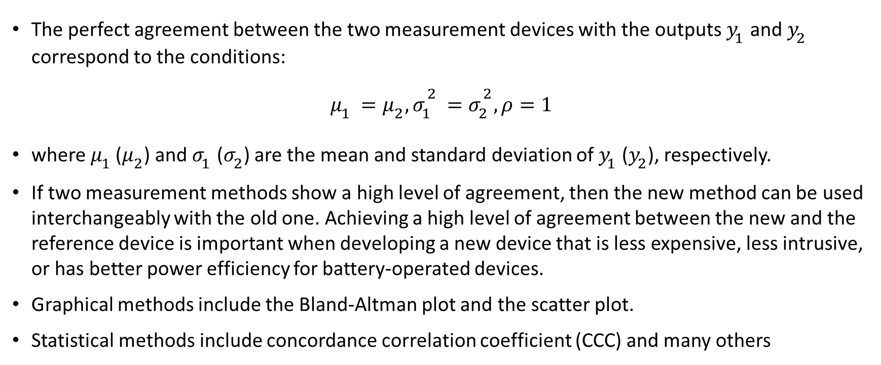
What is the agreement between two paired measurements?
The perfect agreement between the two measurement devices with the outputs $y_{1}$ and $y_{2}$ correspond to the conditions:
$μ_{1}=μ_{2}, σ_{1}^{2}=σ_{2}^{2}, ρ=1$
where $μ_{1 }$($μ_{2}$) and $σ_{1}$ ($σ_{2}$) are the mean and standard deviation of $y_{1}$($y_{2}$), respectively.
If two measurement methods show a high level of agreement, then the new method can be used interchangeably with the old one. Achieving a high level of agreement between the new and the reference device is important when developing a new device that is less expensive, less intrusive, or has better power efficiency for battery-operated devices.
Graphical methods include the Bland-Altman plot and the scatter plot.
Statistical methods include concordance correlation coefficient (CCC) and many others

Slide 22
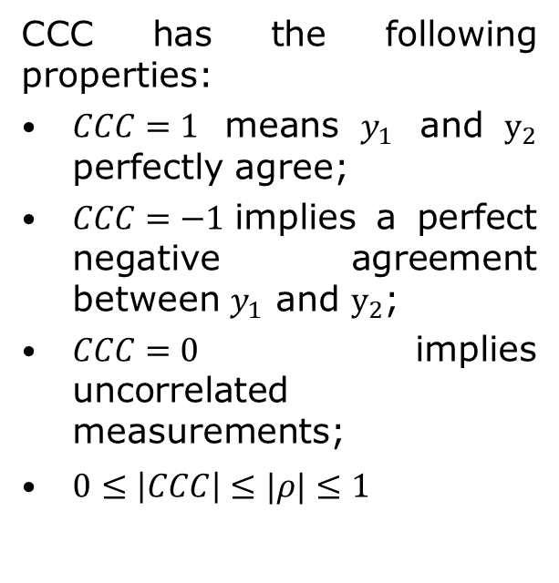
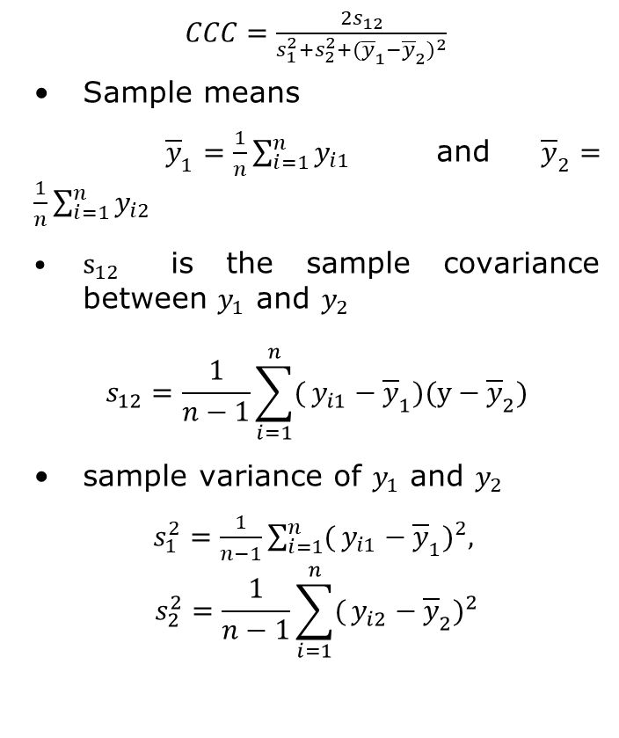
How can we quantify agreement: Concordance Correlation Coefficient?
$CCC=\frac{{2s}_{12}}{s_{1}^{2}+s_{2}^{2}+({\overline{y}}_{1}−{\overline{y}}_{2})^{2}}$
Sample means
${\overline{y}}_{1}=\frac{1}{n}\sum_{i=1}^{n}{y_{i1}}$ and ${\overline{y}}_{2}=\frac{1}{n}\sum_{i=1}^{n}{y_{i2}}$
$s_{12}$ is the sample covariance between $y_{1}$ and $y_{2}$
$$s_{12}=\frac{1}{n−1}\sum_{i=1}^{n}{(}y_{i1}−{\overline{y}}_{1})(y−{\overline{y}}_{2})$$
sample variance of $y_{1}$ and $y_{2}$
$s_{1}^{2}=\frac{1}{n−1}\sum_{i=1}^{n}{(}y_{i1}−{\overline{y}}_{1})^{2},$ $$s_{2}^{2}=\frac{1}{n−1}\sum_{i=1}^{n}{(}y_{i2}−{\overline{y}}_{2})^{2}$$
CCC has the following properties:
$CCC=1$ means $y_{1}$ and $y_{2}$ perfectly agree;
$CCC=−1$implies a perfect negative agreement between $y_{1}$ and $y_{2}$;
$CCC=0$ implies uncorrelated measurements;
$0≤\left|CCC\right|≤|ρ|≤1$

Slide 23
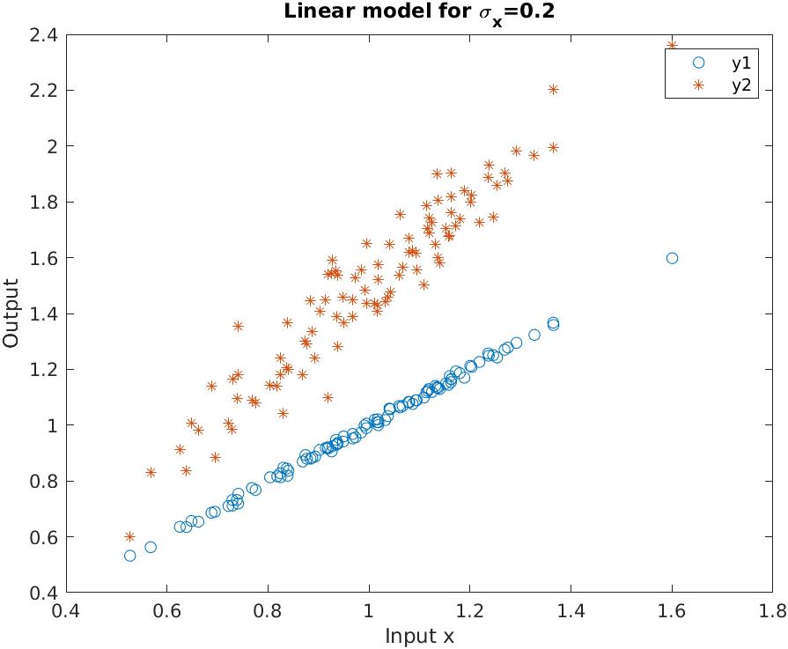
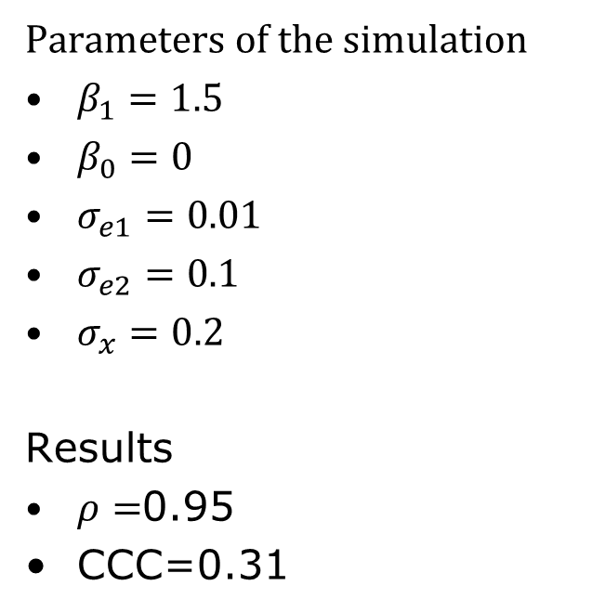
Example of CCC
Parameters of the simulation
$β_{1}=1.5$
$β_{0}=0$
$σ_{e1}=0.01$
$σ_{e2}=0.1$
$σ_{x}=0.2$
Results
$ρ=$0.95
CCC=0.31
To run the program, go to EMBC Matlab\Part 1\accuracy.mlx

Slide 24
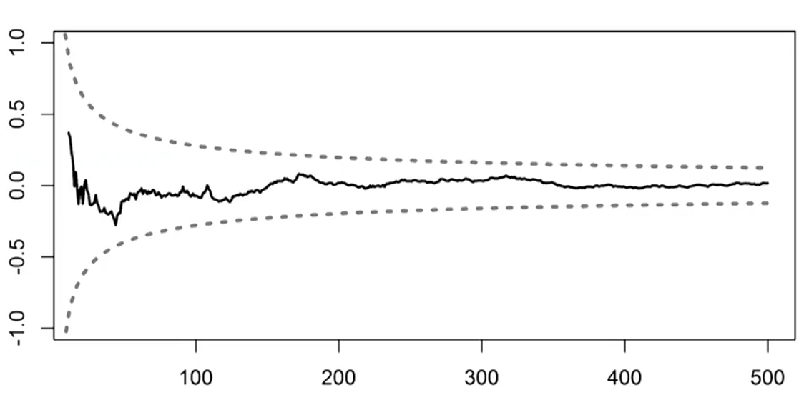
How can we present uncertainty?
Standard error
Heart rate is (60 ± 4) beats/minute (mean ± standard error)
Confidence intervals
95% confidence for the heart rate is [52,68] beats/minute
Probability distributions
Determining different moments or quantiles
Prediction levels over time
Notes:
Intro to uncertainty quantification: https://nanohub.org/resources/10694

Slide 25
What are confidence intervals for Normal random variable?
The value of the statistic in the data sample (eg., mean, median, etc.)
point estimate ± (measure of how confident we want to be) × (standard error)
From a Z table or a T table, depending on the sampling distribution of the statistic.
Standard error of the statistic.

Slide 26
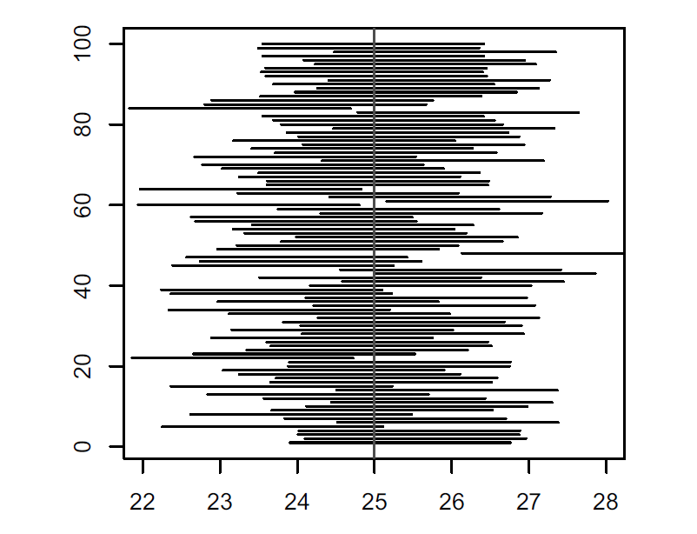
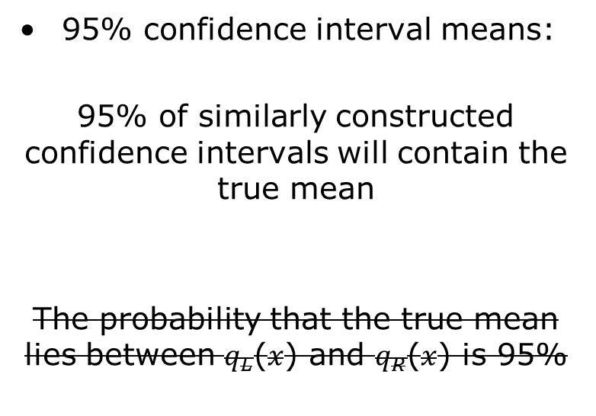
How can we interpret confidence intervals?
95% confidence interval means:
95% of similarly constructed confidence intervals will contain the true mean
The probability that the true mean lies between $q_{L}$($x$) and $q_{R}$($x$) is 95%
Notes:
u

Slide 27
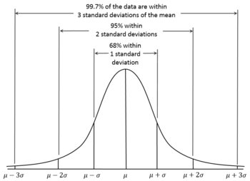

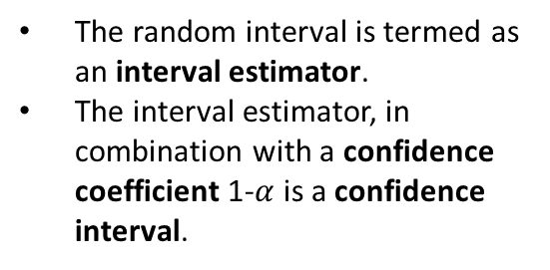
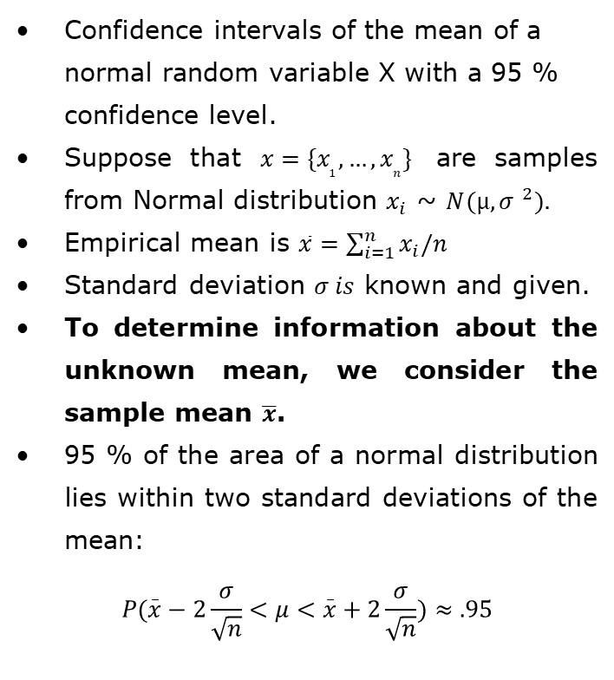
How to compute 95% confidence intervals of a sample mean with known $σ?$
Confidence intervals of the mean of a normal random variable X with a 95 % confidence level.
Suppose that $x=\{x_{1},…,x_{n}\}$ are samples from Normal distribution $x_{i}$ ~ $N(µ, {σ }^{2}).$
Empirical mean is $\overline{x}=\sum_{i=1}^{n}{x_{i}/n}$
Standard deviation $σ is$ known and given.
To determine information about the unknown mean, we consider the sample mean $\overline{x}$.
95 % of the area of a normal distribution lies within two standard deviations of the mean:
$$P(\overset{_}{x}−2\frac{σ}{\sqrt{n}}<μ<\overset{_}{x}+2\frac{σ}{\sqrt{n}})≈.95$$
The random interval is termed as an interval estimator.
The interval estimator, in combination with a confidence coefficient 1-$α$ is a confidence interval.
Notes:
If $x_{i}$, for $i=1,…,n,$are independently and identically sampled from the normal distribution with the mean $μ$ and standard deviation $σ$, then the random variable
$$\begin{aligned}z=\frac{\overline{x}−μ}{\frac{σ}{\sqrt{n}}}\end{aligned}$$
has a standard normal distribution $N(z;0, 1)$.

Slide 28
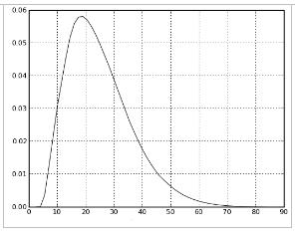
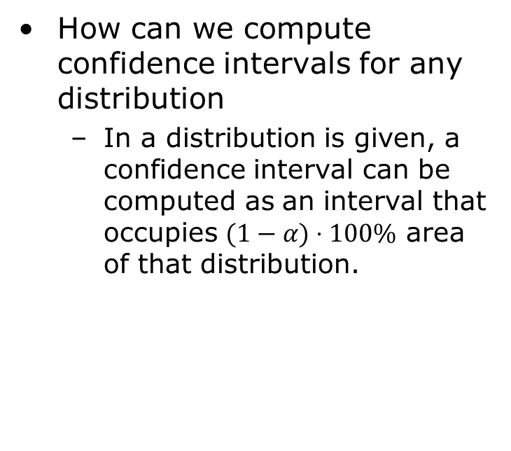
How can we compute confidence intervals from any distribution?
How can we compute confidence intervals for any distribution
In a distribution is given, a confidence interval can be computed as an interval that occupies $(1−α)⋅100\%$ area of that distribution.
How can we compute confidence intervals if we only have data points (measurements)?
Form empirical distribution (based on a histogram)
Posterior
Distribution
95% probability the parameter is here
2.5%
2.5%

Slide 29
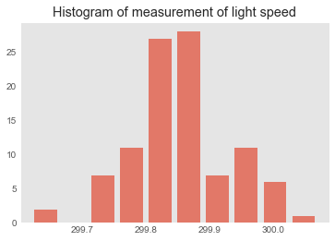
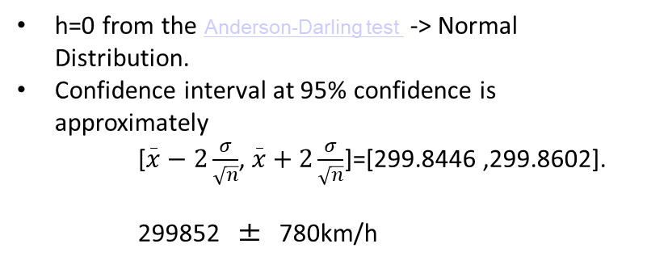
Example of quantifying uncertainty in measuring the speed of light
n=87 measurements are performed and the results are presented on the histogram
What are 95% confidence intervals?
Use Kolmogorov tests to determine normality
Model the data and measurement errors and perform Bayesian estimation of the parameters.
How likely is it that we would see a collection of samples like this if they were drawn from that probability distribution?
[h,p,adstat,cv] = adtest(x)
h=0 from the Anderson-Darling test -> Normal Distribution.
Confidence interval at 95% confidence is approximately
[$\overset{_}{x}−2\frac{σ}{\sqrt{n}}$, $\overset{_}{x}+2\frac{σ}{\sqrt{n}}$]=[299.8446 ,299.8602].
299852 ± 780km/h
To run the program, go to EMBC Matlab\Part 1\UncertaintyCIs.mlx

Slide 30
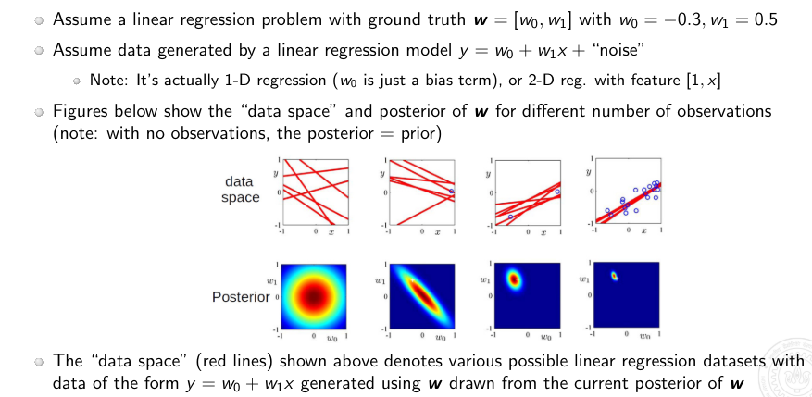
How can we represent regression model uncertainty?
This slide is from lectures by Professor P.Rai: https://www.cse.iitk.ac.in/users/piyush/courses/tpmi_winter19/tpmi_w19_lec5_slides_print.pdf
Notes:
https://www.cse.iitk.ac.in/users/piyush/courses/tpmi_winter19/tpmi_w19_lec5_slides_print.pdf

Slide 31
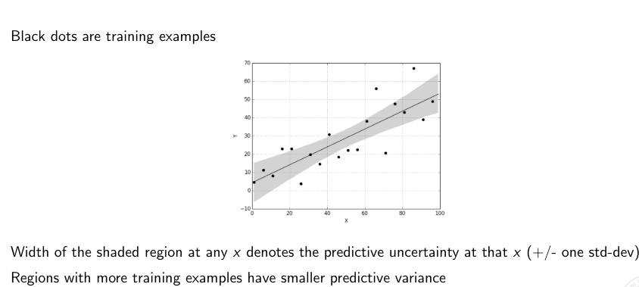
Posterior predictive distribution
This slide is from lectures by Professor P.Rai: https://www.cse.iitk.ac.in/users/piyush/courses/tpmi_winter19/tpmi_w19_lec5_slides_print.pdf
Notes:
Questions:
What if the data point comes outside of the values x for which the training was done?
How do we report the prodictions here

Slide 32
Outline
Introduction
Part 1: Errors and uncertainty quantification
Definitions of errors and agreement
Uncertainty quantification
Part 2: Uncertainty propagation and sensitivity analysis
Workflow that includes model, parameter estimation, uncertainty propagation and sensitivity analysis
Uncertainty propagation based on perturbation and Monte Carlo sampling
Part 3: Modeling biomedical systems
Modeling signal generation, noise and assessing signal quality
Part 4: Uncertainty propagation/sensitivity analysis through more complex models
Modeling continuous blood pressure devices
Modeling oscillometric algorithms
Part 5: Conclusion

Slide 33
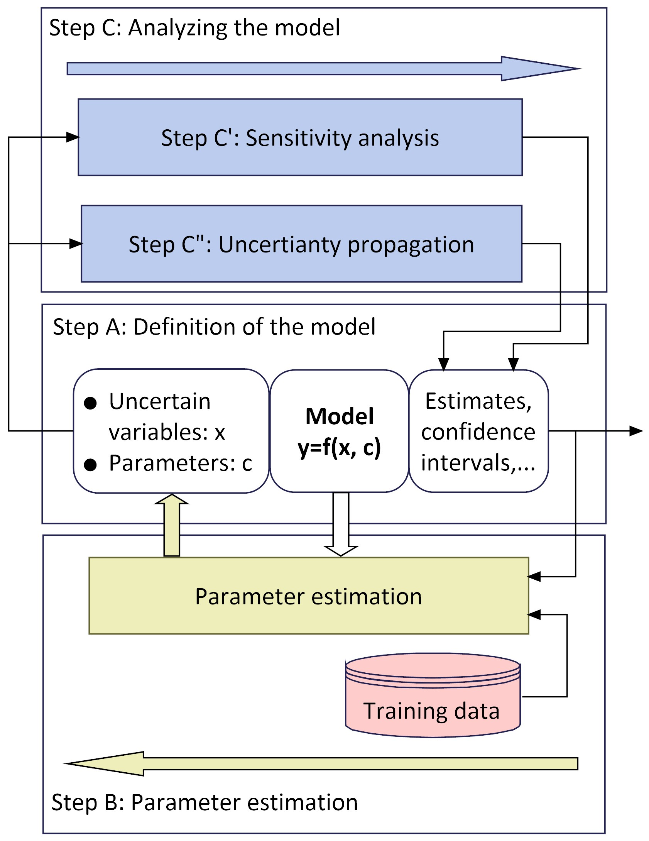
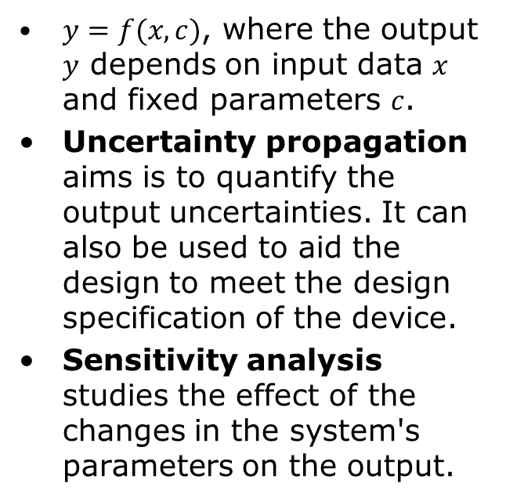
What is the workflow for Uncertainty Quantification and Sensitivity Analysis?
$y=f(x,c)$, where the output $y$ depends on input data $x$ and fixed parameters $c$.
Uncertainty propagation aims is to quantify the output uncertainties. It can also be used to aid the design to meet the design specification of the device.
Sensitivity analysis studies the effect of the changes in the system's parameters on the output.

Slide 34
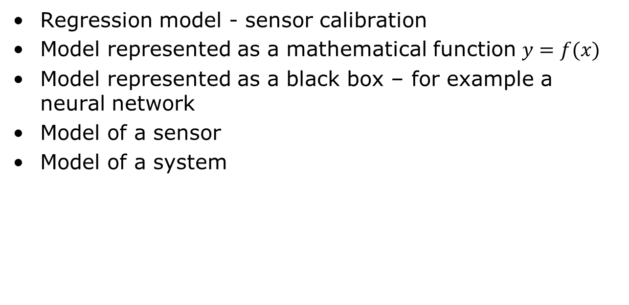
What are the models that we consider here?
Regression model - sensor calibration
Model represented as a mathematical function $y=f(x)$
Model represented as a black box – for example a neural network
Model of a sensor
Model of a system

Slide 35
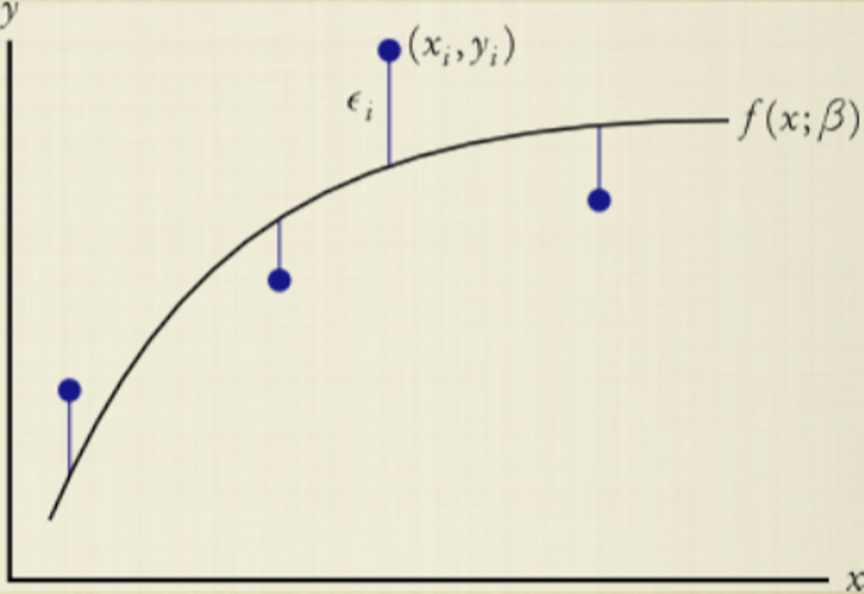
What is parameter estimation?
Parameter estimation is the process of adjusting unknown model parameters in order to improve the agreement between model output and observed data
Involves “tuning” values of the parameters of the model to best match the observed data
Methods
Maximum likelihood methods
Model is used with fitted parameters to predict future behavior of the system
Bayesian methods for parameter estimation
the predictions allow for all sources of uncertainty, including the remaining uncertainty over the fitted parameters

Slide 36
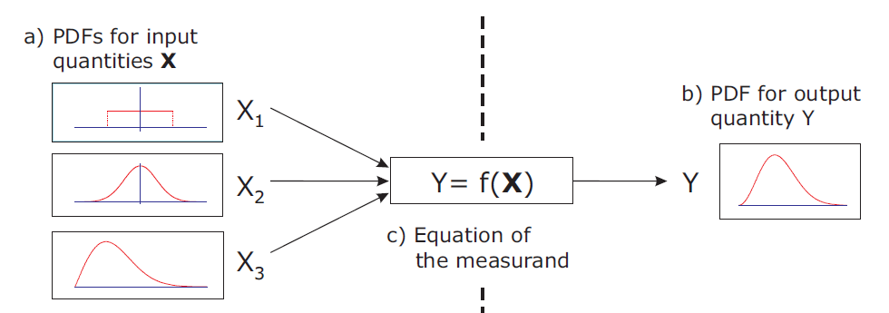
What is uncertainty propagation?
If we have a model that has probabilistic or uncertain parameters, and the data is noisy, how can we quantify uncertainty at the output of our system?
Propagation of uncertainty quantifies the effect of the uncertainty in parameters and input variables on the output.
Perturbation methods
the solution is expressed using a suitable Taylor series expansion
Sampling techniques
Monte Carlo based
The uncertainty budget represents the combination of all uncertainties in the system, and it is commonly used in meeting the specifications of the device.

Slide 37
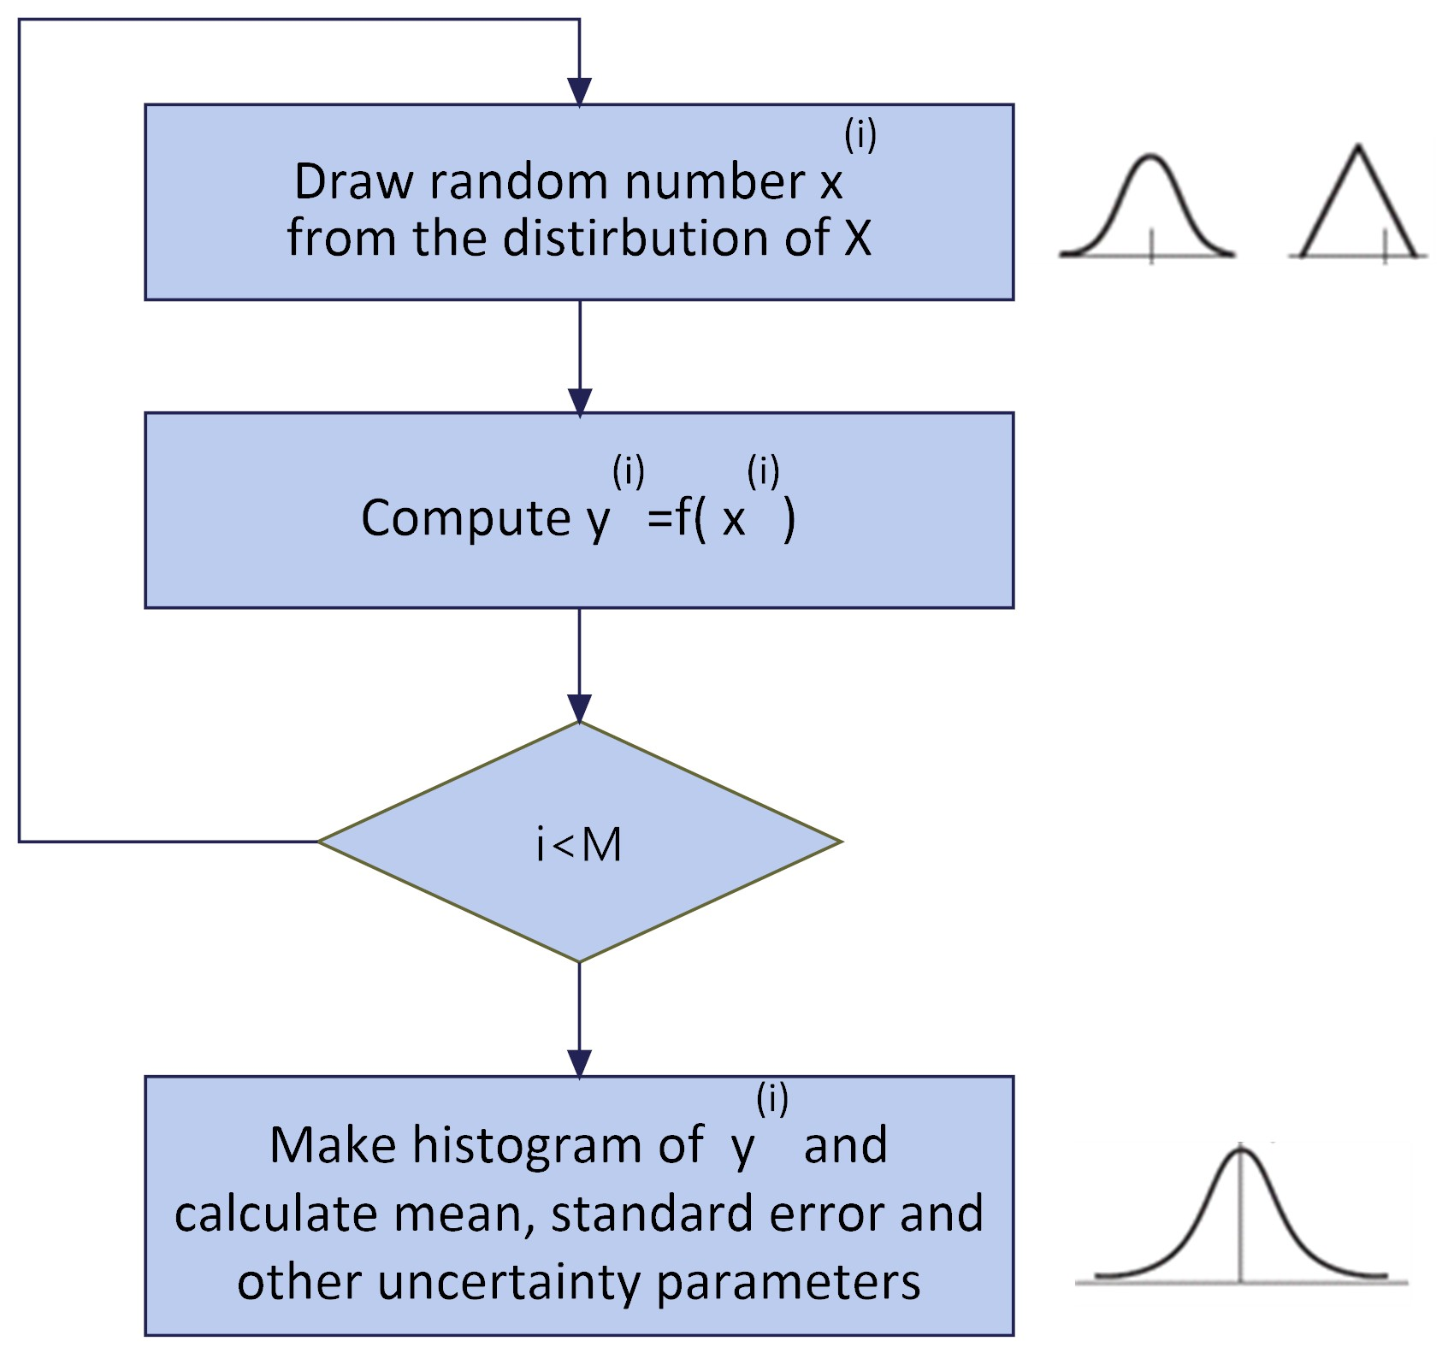
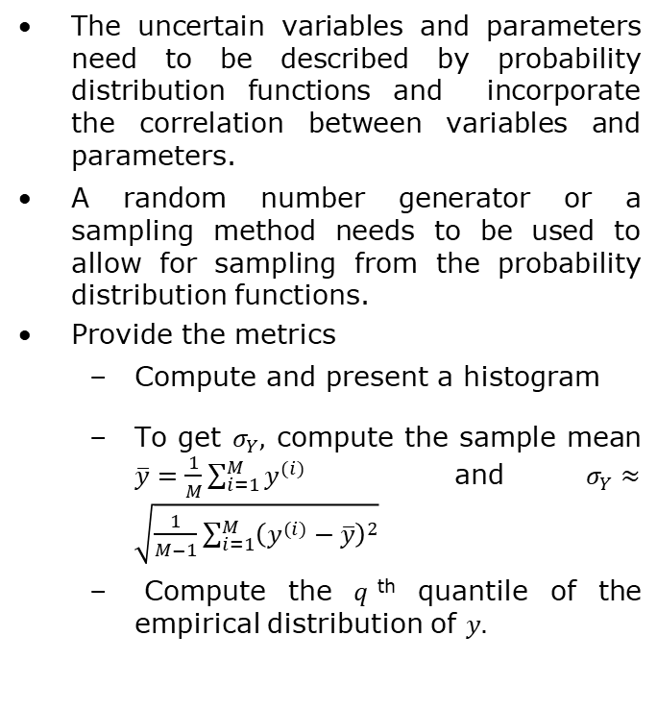
How can we use Monte Carlo sampling steps for uncertainty propagation?
The uncertain variables and parameters need to be described by probability distribution functions and incorporate the correlation between variables and parameters.
A random number generator or a sampling method needs to be used to allow for sampling from the probability distribution functions.
Provide the metrics
Compute and present a histogram
To get $σ_{Y},$ compute the sample mean $\overline{y}=\frac{1}{M}\sum_{i=1}^{M}{y^{(i)}}$ and $σ_{Y}≈\sqrt{\frac{1}{M−1}\sum_{i=1}^{M}{{\left(y^{(i)}−\overline{y}\right)}^{2}}}$
Compute the $q$^{th} quantile of the empirical distribution of $y.$

Slide 38
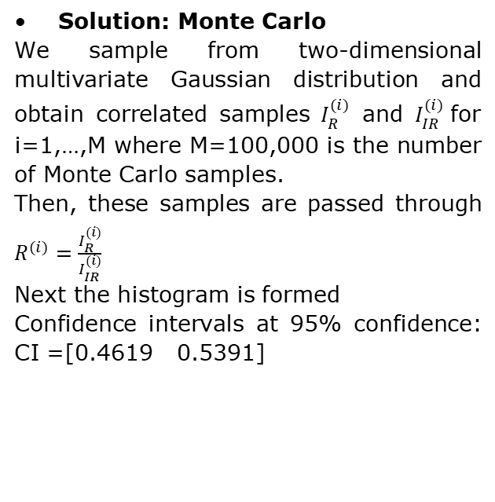
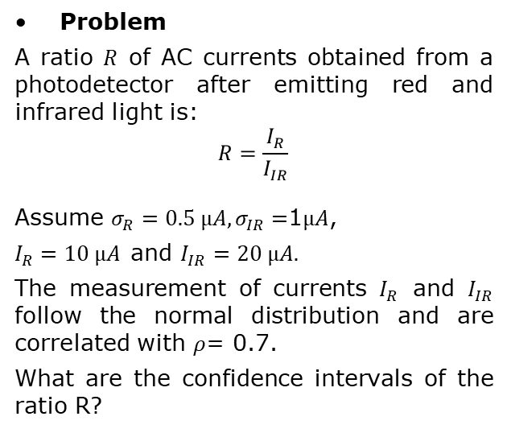
Example of uncertainty propagation
Problem
A ratio $R$ of AC currents obtained from a photodetector after emitting red and infrared light is:
$$R=\frac{I_{R}}{I_{IR}}$$
Assume $σ_{R}=0.5{ µA, σ}_{IR}=$1$µA$,
$I_{R}=10 µA$and $I_{IR}=20 µA.$
The measurement of currents $I_{R}$ and $I_{IR}$ follow the normal distribution and are correlated with $ρ$= 0.7.
What are the confidence intervals of the ratio R?
Solution: Monte Carlo
We sample from two-dimensional multivariate Gaussian distribution and obtain correlated samples $I_{R}^{(i)}$ and $I_{IR}^{(i)}$for i=1,…,M where M=100,000 is the number of Monte Carlo samples.
Then, these samples are passed through $R^{(i)}=\frac{I_{R}^{(i)}}{I_{IR}^{(i)}}$
Next the histogram is formed
Confidence intervals at 95% confidence: CI =[0.4619 0.5391]
To run the program, go to EMBC Matlab\Part 2\UncertaintyPropagation.mlx, Example 1

Slide 39
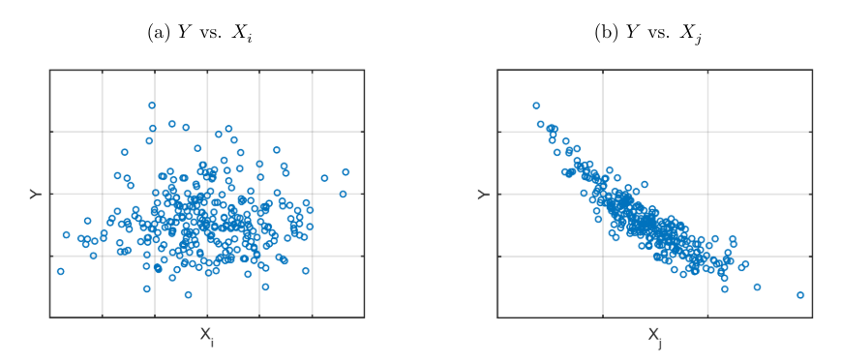
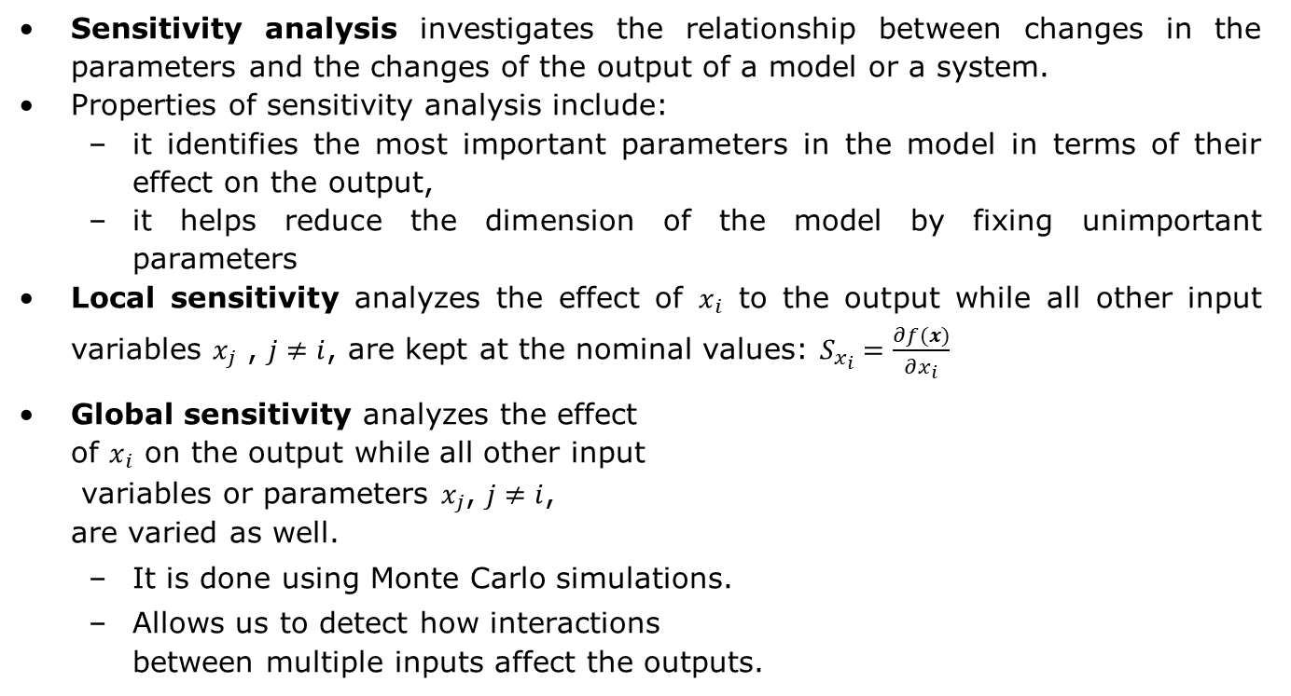
What is sensitivity analysis?
Sensitivity analysis investigates the relationship between changes in the parameters and the changes of the output of a model or a system.
Properties of sensitivity analysis include:
it identifies the most important parameters in the model in terms of their effect on the output,
it helps reduce the dimension of the model by fixing unimportant parameters
Local sensitivity analyzes the effect of $x_{i}$ to the output while all other input variables $x_{j}$ , $j≠i$, are kept at the nominal values: $S_{x_{i}}=\frac{∂f(x)}{∂x_{i}}$
Global sensitivity analyzes the effect of $x_{i}$ on the output while all other input variables or parameters $x_{j}$, $j≠i$, are varied as well.
It is done using Monte Carlo simulations.
Allows us to detect how interactions between multiple inputs affect the outputs.

Slide 40
How can we define a cost function for sensitivity analysis?
Generate samples from a parameter space
Define a cost function
Compute the cost function for each combination of parameter values using Monte Carlo simulations and evaluate the results.
Analyze statistical relations between the parameters and the cost function and determine what parameters affect the cost function the most
Use the results to modify or improve the model

Slide 41
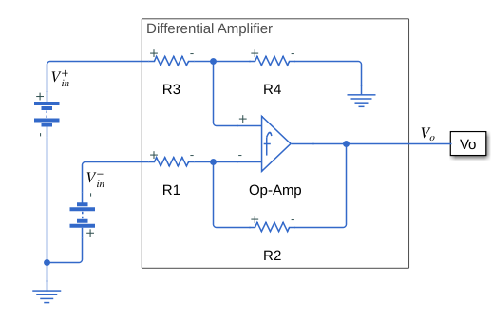
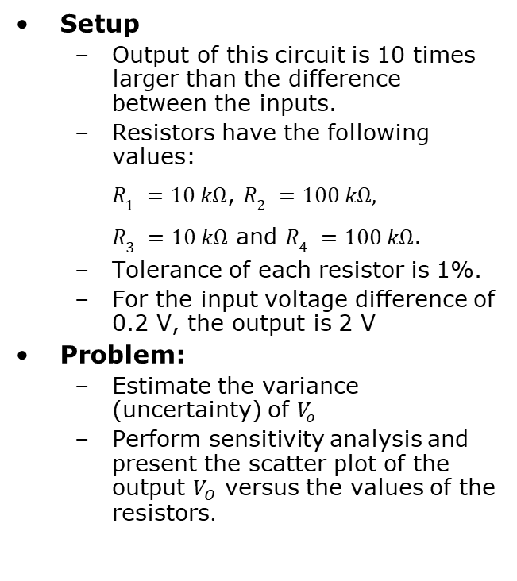
Example: Differential Amplifier
Setup
Output of this circuit is 10 times larger than the difference between the inputs.
Resistors have the following values: $R_{1}=10 kΩ$, $R_{2}=100 kΩ,$ $R_{3}=10 kΩ$ and $R_{4}=100 kΩ$.
Tolerance of each resistor is 1%.
For the input voltage difference of 0.2 V, the output is 2 V
Problem:
Estimate the variance (uncertainty) of $V_{o}$
Perform sensitivity analysis and present the scatter plot of the output $V_{O}$ versus the values of the resistors.
To run the program, go to EMBC Matlab\Part 2\ Uncertainty_diff_ampl1.mlx

Slide 42
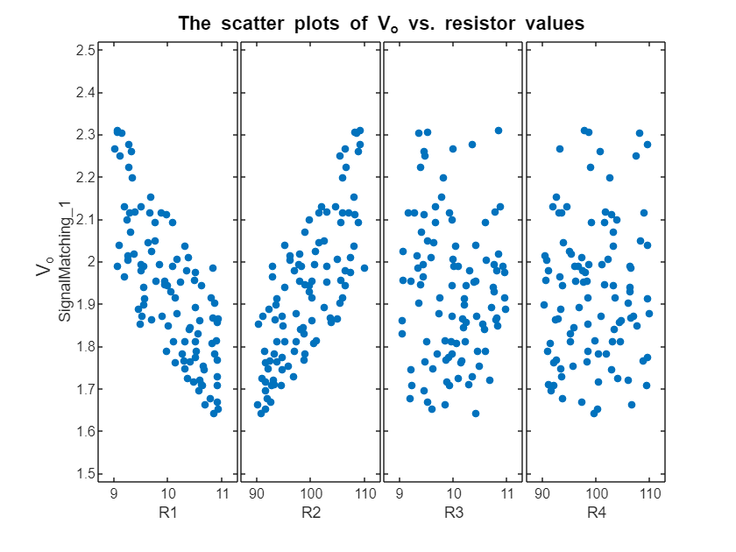
Scatter plot of the amplifier output and the values of the resistors
Correlation coefficients computed between the values of each resistor and the output are: [-0.77, 0.76, -0.04, 0.07]
We can see that the output of the system is much more affected by changes in the resistance of resistors R1 and R2 than by changes in the resistance of resistors R3 and R4.
Therefore, it is more important to select resistors R1 and R2 to have low tolerances because large tolerances in these resistors will result in large variations in the output.
To run the program, go to EMBC Matlab\Part 2\Sens_analysis.mlx

Slide 43
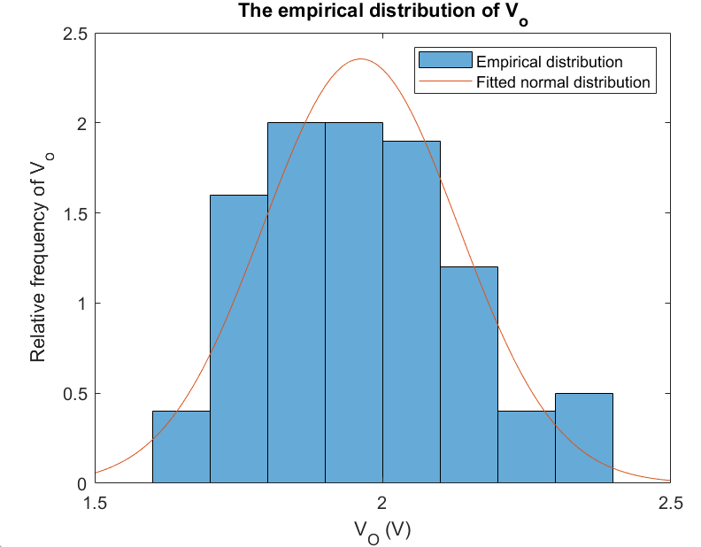
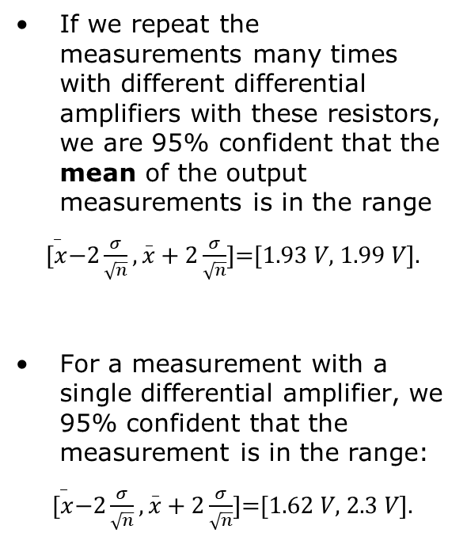
Empirical distribution of the output voltage of the differential amplifier
If we repeat the measurements many times with different differential amplifiers with these resistors, we are 95% confident that the mean of the output measurements is in the range
$\overset{_}{[x}−2\frac{σ}{\sqrt{n}}, \overset{_}{x}+2\frac{σ}{\sqrt{n}}$]=[1.93 𝑉, 1.99 𝑉].
For a measurement with a single differential amplifier, we 95% confident that the measurement is in the range:
$\overset{_}{[x}−2\frac{σ}{\sqrt{n}}, \overset{_}{x}+2\frac{σ}{\sqrt{n}}$]=[1.62 𝑉, 2.3 𝑉].
To run the program, go to EMBC Matlab\Part 2\Uncertainty_diff_ampl1.mlx

Slide 44
Outline
Introduction (10 min)
Part 1: Errors and uncertainty quantification
Definitions of errors and agreement
Uncertainty quantification
Part 2: Uncertainty propagation and sensitivity analysis
Workflow that includes model, parameter estimation, uncertainty propagation and sensitivity analysis
Uncertainty propagation based on perturbation and Monte Carlo sampling
Part 3: Modeling biomedical systems
Modeling signal generation, noise and assessing signal quality
Part 4: Uncertainty propagation/sensitivity analysis through more complex models
Modeling continuous blood pressure devices
Modeling oscillometric algorithms
Part 5: Conclusion

Slide 45
General model of a biomedical system

Slide 46
What is forward and inverse modeling?
There are two main ways to assign values to the parameters of an interpretable model, including:
Based on the previous knowledge (forward modeling)
Based on parameter estimation or model fitting (inverse modeling) that minimizes the error between the model output and the experimental data.
Example: Parameter estimation and sensitivity analysis for Windkessel model

Slide 47
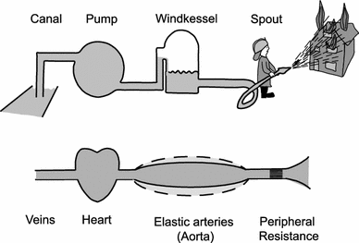
What is Windkessel effect?
Windkessel effect explains the phenomenon of the conversion of the pulsatile blood flow into the continuous blood flow in blood vessels.
Windkessel means an air chamber in German
Applications include:
Estimation of cardiac output
Estimation of total peripheral resistance
Estimation of total arterial compliance
Estimation of aortic input impedance
Estimation of stroke volume
Estimation of central aortic pressure
The figure is from: N. Westerhof, J.W. Lankhaar, & B.E. Westerhof, “The arterial Windkessel” Med Biol Eng Comput 47, 131–141 (2009).
Notes:
The concept of the Windkessel. The air reservoir is the actual Windkessel, and the large arteries act as the Windkessel. The combination of compliance, together with aortic valves and peripheral resistance, results in a rather constant peripheral flow
P= CO*SVR:
CO=SV*HR

Slide 48
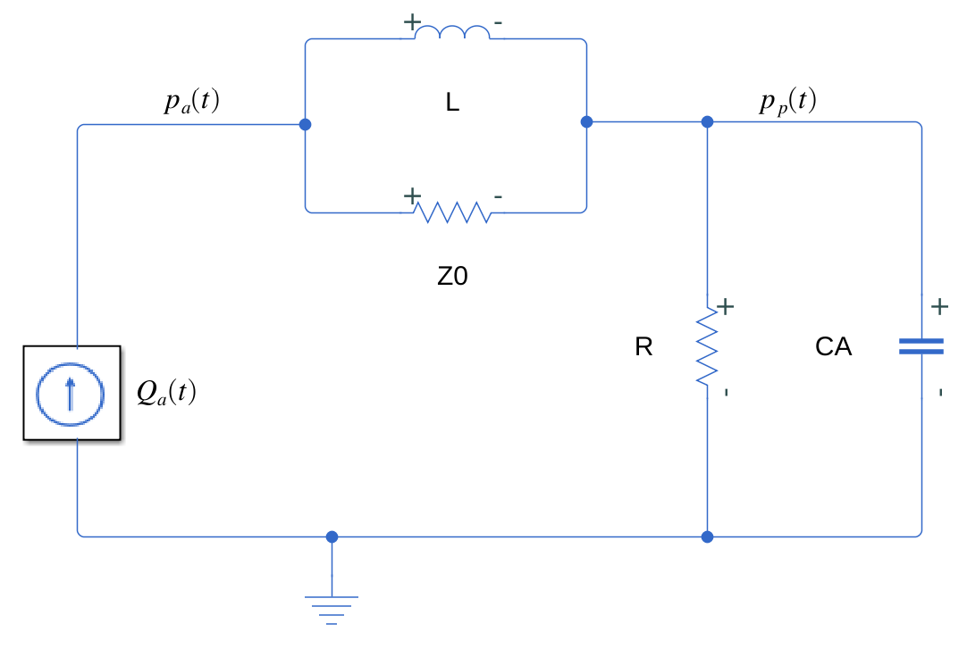
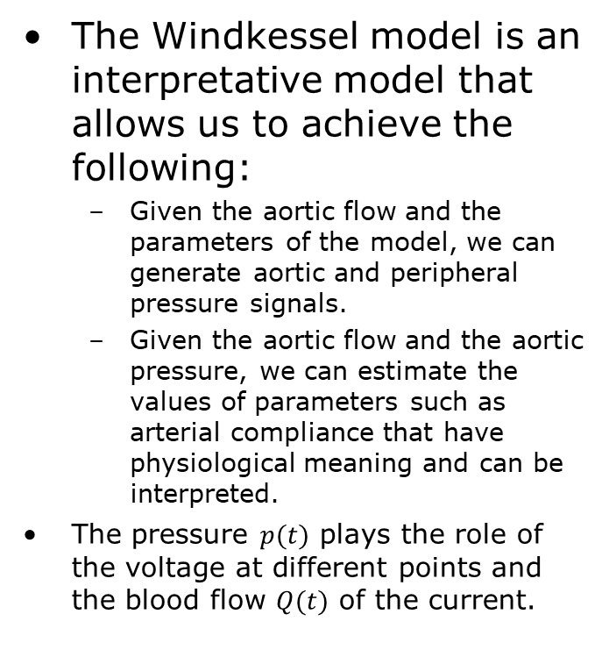
Four-element Windkessel model
The Windkessel model is an interpretative model that allows us to achieve the following:
Given the aortic flow and the parameters of the model, we can generate aortic and peripheral pressure signals.
Given the aortic flow and the aortic pressure, we can estimate the values of parameters such as arterial compliance that have physiological meaning and can be interpreted.
The pressure $p(t)$ plays the role of the voltage at different points and the blood flow $Q(t)$ of the current.

Slide 49
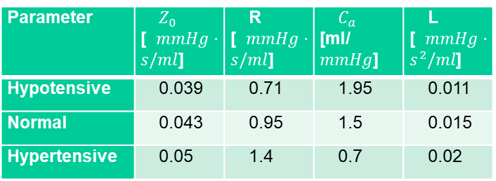
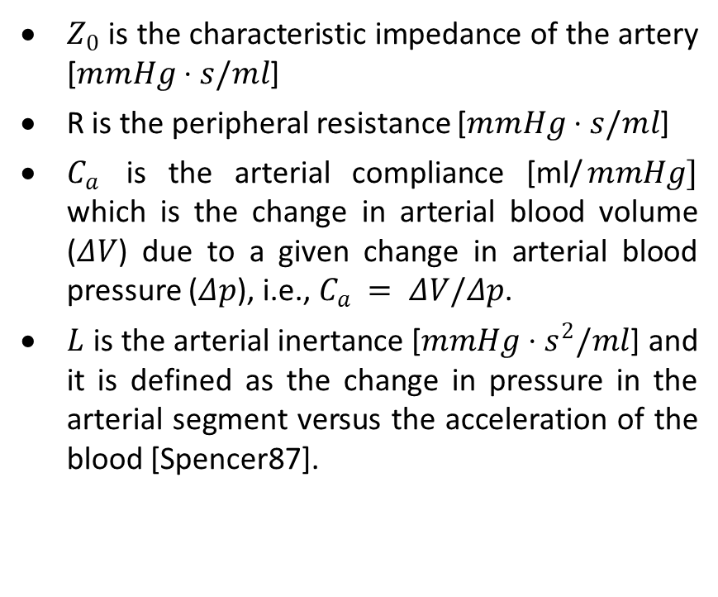
What are common values for the parameters of Windkessel model?
$Z_{0}$ is the characteristic impedance of the artery [$mmHg⋅s/ml$]
R is the peripheral resistance [$mmHg⋅s/ml$]
$C_{a}$ is the arterial compliance [ml/$mmHg]$ which is the change in arterial blood volume ($ΔV$) due to a given change in arterial blood pressure ($Δp$), i.e., $C_{a} = ΔV/Δp$.
$L$ is the arterial inertance [$mmHg⋅s^{2}/ml$] and it is defined as the change in pressure in the arterial segment versus the acceleration of the blood [Spencer87].
Parameter | $Z_{0}$ [$mmHg⋅s/ml$] | R [$mmHg⋅s/ml$] | $C_{a}$ [ml/$mmHg$] | L [$mmHg⋅s^{2}/ml$]
Hypotensive | 0.039 | 0.71 | 1.95 | 0.011
Normal | 0.043 | 0.95 | 1.5 | 0.015
Hypertensive | 0.05 | 1.4 | 0.7 | 0.02
Notes:
Compliance is equivalent to the capacitance in electrical circuits in the following way: Capacitance accumulates the charge and then discharges it to the same circuit. Similarly, compliance represents the ability of arteries to expand during the systole accumulating a volume of blood. During the diastole, this volume of blood is discharged along the arteries.

Slide 50
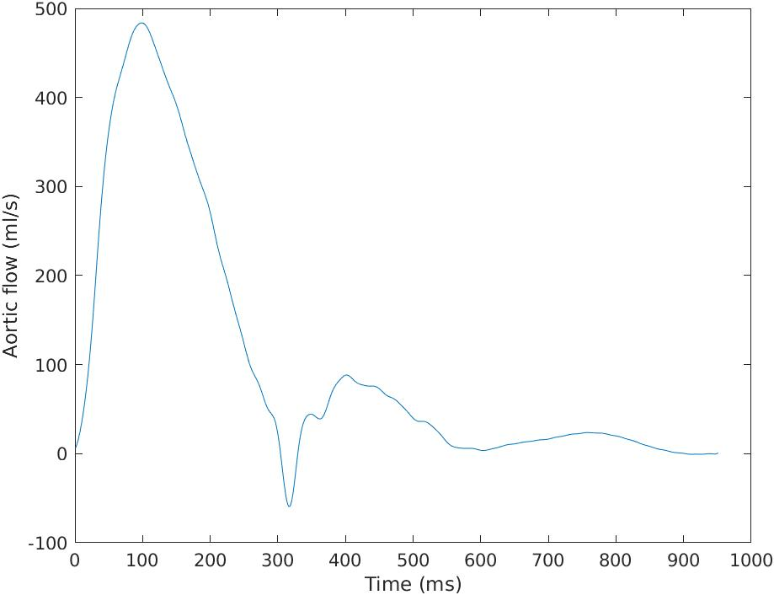
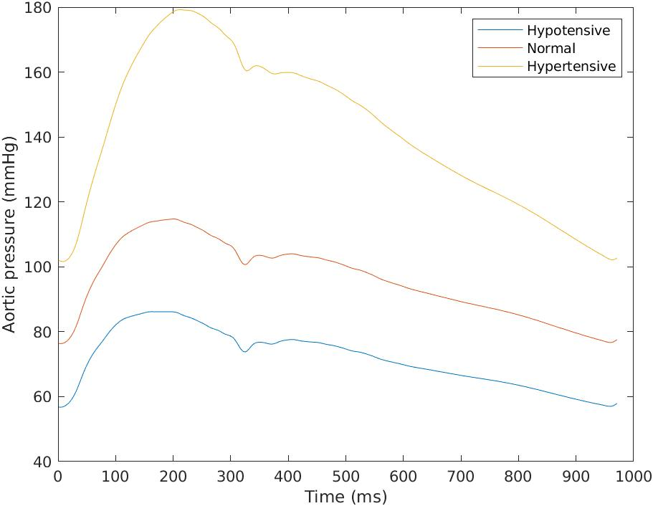
Arterial flow measured from a healthy subject and aortic pressure
To run the program, go to EMBC Matlab\Part 3\WK2.mlx section “Forward Modeling”.

Slide 51
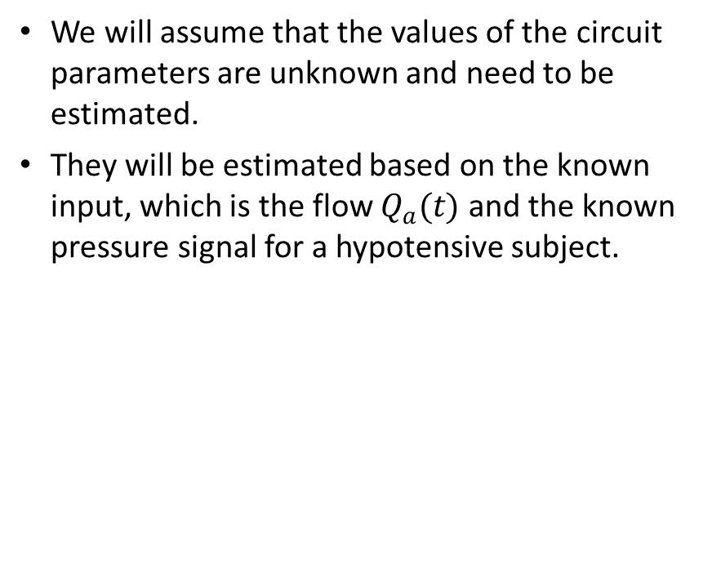
Sensitivity analysis and parameter estimation
We will assume that the values of the circuit parameters are unknown and need to be estimated.
They will be estimated based on the known input, which is the flow $Q_{a}(t)$ and the known pressure signal for a hypotensive subject.
The following steps were followed:
Sensitivity analysis to determine the initial values of the parameters for the estimation
Selection of parameters that need to be optimized and their minimum and maximum values
Fitting the parameters (parameter estimation) of the model.

Slide 52



Scatter plot and the reference vs. simulated pressure pulse
Parameter | $Z_{0}$ [$mmHg⋅s/ml$] | R [$mmHg⋅s/ml$] | $C_{a}$ [ml/$mmHg$] | L [$mmHg⋅s^{2}/ml$]
Original parameters | 0.039 | 0.71 | 1.95 | 0.011
Estimated parameters | 0.0386 | 0.71 | 2.036 | 0.0138
To run the program, go to EMBC Matlab\Part 3\WK2.mlx section “Sensitivity analysis and fitting the model”.

Slide 53
What are common types of noise
Based on the portion of the overall signal bandwidth that the noise occupies, it can be classified as narrowband and wideband/broadband.
White noise (such as thermal noise) occupies the whole bandwidth and is broadband.
Narrowband noise would be 60 Hz noise from the device itself.
Noise can also be classified as low, middle and high-frequency noise. In biomedical instrumentation, low-frequency noise can cause baseline wander.
If the unwanted signal comes from external sources, it is called interference.
Quantization noise is the noise introduced due to quantization process of A/D converters.
Additive noise refers to the unwanted signal added to the signal of interest.
Multiplicative noise modulates the amplitude of the signal. In biomedical instrumentation, we commonly consider additive noise.

Slide 54

How can we model the noise based on the spectral density?
We can model the noise by looking at its spectral content. This can be modeled by a single parameter representing the slope of a power spectral density function $S(f)$ that decreases monotonically with frequency [Sameni08]:
$$S\left(f\right)∝\frac{1}{f^{β}}$$
where β is the noise color parameter.
Different types of noise can be modeled in this case, including:
white noise (β = 0),
pink or flicker noise (β = 1),
brown noise or the random walk process (β = 2).

Slide 55


Modeling 60 Hz noise and baseline drift
1 Hz, 1 V sinewave signal
To run the program, go to EMBC Matlab\Part 3\generating_noise.mlx

Slide 56



Continuous motion artifacts
Input 1 Hz, 1 V sinewave signal corrupted with Gaussian white noise with a standard deviation of $0.01 V,$ and a lowpass filtered Gaussian noise with the amplitude of 0.4 V that simulates motion artifacts.
To run the program, go to EMBC Matlab\Part 3\generating_noise.mlx

Slide 57


Intermittent motion artifacts
Input sinewave signal with an amplitude of $1 V$ and a frequency of $1 Hz$ corrupted with an impulse noise represented using the sinc function.
To run the program, go to EMBC Matlab\Part 3\generating_noise.mlx

Slide 58


Motion artifacts: band-limited noise
Input sinewave signal with an amplitude of $1 V$ and a frequency of $1 Hz$ corrupted with an impulse brown noise.
To run the program, go to EMBC Matlab\Part 3\generating_noise.mlx

Slide 59
What is signal quality
Quality assessment aims to identify and quantify the instances of artifact in a signal segment.
The output of the algorithm is a Signal Quality Index (SQI) that can be binary.
The quality factors are factors that affect the quality of the data.
Procedure for extracting the SQI:
Feature extraction
Comparing outputs of different algorithms that process the same data.
Using features based on empirical thresholds or ML to come up with quality indices
Combining the indices into a single SQI.
Features include:
Morphological features are different for every physiological signal. For example, for ECG signal, the time and amplitudes of waves of interest, including P wave, T wave and QRS complex, are the features.
Template matching could be used to compare different pulses against a reference pulse.
Time-domain features include the rise and fall time of the pulse.
Spectral features include ratios of the spectral power among different frequency regions of interest.
Statistics features include the mean, variance, skewness, kurtosis.

Slide 60

How can we determine signal quality using template matching?
Template matching requires that all the pulses are first detected.
The Pearson correlation coefficient is computed between each pulse and the waveform template.
We expect the correlation between the pulses and the waveform template would be high.
The waveform template is normally unavailable but is computed as the average pulse waveform by performing beat/pulse detection and then ensemble averaging over all pulse waveforms.
Steps
Low-pass filtering
Finding the fiducial points of interest of each pulse
Extracting pulses and performing ensemble averaging to find the waveform template
Calculating the correlation coefficient between each pulse and the template
Determining tSQI for each pulse by comparing the correlation coefficient $ρ$ of each pulse with the threshold
Determining tSQI of the overall segment by averaging $ρ$for the segment.

Slide 61


What are signal quality metrics that are applied to a whole signal segment?
Kurtosis
Spectral power ratio
The random noise samples often follow Gaussian distribution, whereas biomedical signals do not follow it.
The kurtosis of a Gaussian distribution is 3
The estimate of kurtosis of a signal can be represented as:
$$Kurt(x)=E{\left\{x−μ\right\}}^{4}/σ^{4}$$
The kurtosis-based SQI (kSQI) is:
$\text{kSQI}=\left\{\begin{aligned}1,Kurt(x)≥5 \\ 0,, otherwise\end{aligned}\right.$
For the ECG signal, the power peak occurs in range of $[5 Hz, 14 Hz$].
The spectral distribution ratio is the sum of the power of the ECG in the range of $5 Hz$ to $14 Hz$ to the power of the same signal in the range of $5 Hz$ to $60 Hz$.
$$SDR= \int_{f=5}^{f=14}{P\left(f\right)df/\int_{f=5}^{f=60}{P\left(f\right)df }}$$
Spectral power ratio signal quality index (pSQI)
$$\text{pSQI}=\left\{\begin{aligned}1, 0.5<SDR<0.9 \\ 0, otherwise\end{aligned}\right.$$

Slide 62


ECG signal without added noise
Kurtosis, kSQI | Power ratio, pSQI | Average $r$ – no filtering, tSQI | Average $r$ with filtering, tSQI
Kurt=22.2, kSQI=1 | SDR=0.88, pSQI=1 | r=0.99, tSQI=1 | r=0.99, tSQI=1
To run the program, go to EMBC Matlab\Part 3\SQI_notebook.mlx

Slide 63



Filtered ECG signal with Gaussian white noise and 60 Hz interference
Kurtosis, kSQI | Power ratio, pSQI | Average $r$ – no filtering, tSQI | Average $r$ with filtering, tSQI
Kurt=11.8, kSQI=1 | SDR =0.63, pSQI=1 | r=0.82, tSQI=0 | r=0.97, tSQI=1
To run the program, go to EMBC Matlab\Part 3\SQI_notebook.mlx

Slide 64



ECG signal with brown noise.
Kurtosis, kSQI | Power ratio, pSQI | Average $r$ – no filtering, tSQI | Average $r$ with filtering, tSQI
Kurt=11.9, kSQI=1 | SDR =0.89, pSQI=1 | r=0.88, tSQI=0 | r=0.87, tSQI=0
To run the program, go to EMBC Matlab\Part 3\SQI_notebook.mlx

Slide 65
Outline
Introduction (10 min)
Part 1: Errors and uncertainty quantification
Definitions of errors and agreement
Uncertainty quantification
Part 2: Uncertainty propagation and sensitivity analysis
Workflow that includes model, parameter estimation, uncertainty propagation and sensitivity analysis
Uncertainty propagation based on perturbation and Monte Carlo sampling
Part 3: Modeling biomedical systems
Modeling signal generation, noise and assessing signal quality
Part 4: Uncertainty propagation/sensitivity analysis through more complex models
Modeling continuous blood pressure devices
Modeling oscillometric algorithms
Part 5: Conclusion

Slide 66

What is pulse wave velocity?
An arterial pressure wave is a pressure impulse wave generated at the heart during the aortic valve opening that propagates along the entire arterial tree, widening the walls of each artery.
Pulse wave velocity (PWV) is defined as the velocity of a pressure wave that propagates between two points in the arterial system, which varies from 5–15 m/s in the central artery to higher values in peripheral arteries.
PWV is measured as the distance travelled by the pressure pulse along the arterial tree divided by the elapsed time or pulse transit time (PTT).
Pressure pulse wave velocity is not blood velocity but rather the velocity of the pressure wave propagation along the wall of the arterial tree.
While the blood velocity is between $0.2 m/s$ and $0.4 m/s$, pulse wave velocity is from $5 m/s$ to more than $20 m/s$ in different arteries.
Higher values of PWV normally mean higher arterial stiffness.
The carotid-femoral pulse wave velocity (cfPWV) is the velocity at which the pressure wave propagates between the carotid and the femoral arteries. It can be regarded as an indicator of high cardiovascular risk for cfPWV values above 10m/s. It is commonly used as an index for arterial stiffness.

Slide 67
How is PWV related to stiffness?
Speed at which pressure pulse propagates is defined as :
PWV=l/T
l distance between two points of pulse measurements
T=PTT transit time between those two points
Pulse wave velocity (velocity of propagation of arterial pulse ) is dependent on dimensions and stiffness of vessels.
Distensibility (the capacity to swell as a result of pressure from inside) is defined as the percentage variation in diameter for each increase in blood pressure of 1 mmHg
Distensibility = (3.57/PWV) ²;
PWV of 4 m/s corresponds to distensibility of 0.80%;
PWV of 16 m/s corresponds to distensibility of 0.05%.
Used as an index of the aging arteries
Velocity of transmission is considerably lower in large vessels in comparison to small vessels
Aorta has a greater elasticity and contains a much greater amount of elastic tissue.
Pressure inside arteries will affect arterial distensibility and consequently PWV
Arteriosclerosis -> thickening of arteries -> high blood pressure -> Low vessel elasticity

Slide 68

How can one measure PWV?
Two transducers are simultaneously used (tonometers, ultrasound probes, oscillometers):
From: P. Salvi, Pulse Waves: How Vascular Hemodynamics Affects Blood Pressure, Springer, 2nd Edition, 2017.

Slide 69

What is pulse arrival time?
Pulse arrival time (PAT) is the time delay between the peak of the R-wave of an ECG waveform and the minimum of the pulse of the blood pressure waveform in the same cardiac cycle.
PAT equals the sum of PTT and the pre-ejection period (PEP).
PEP is the time delay between the Q-wave of an ECG and the opening of the aortic valve. It represents the interval from the start of electrical stimulation of the ventricles until the mechanical opening of the aortic valve.
It was concluded that PAT might not be an adequate alternative for PTT as a marker of blood pressure.

Slide 70


What are systolic and diastolic blood pressures?
Systolic pressure (SBP) is defined as the maximum pressure exerted by the blood against the arterial walls. The minimum value of the arterial pulse represents the diastolic pressure.
Diastolic pressure (DBP) results from ventricular relaxation during the diastole.
The difference between systolic and diastolic pressure is called the pulse pressure $PP=SBP−DBP$.
The dicrotic notch represents the interruption of the smooth flow of blood at the moment when the aortic valve closes.
The yellow area of the pulses between the diastolic point and dicrotic notch is called systole, while the green area between the dicrotic notch and the diastolic point of the next cardiac cycle is called diastole.
BP is commonly reported in terms of SBP over DBP and is expressed in millimeters of mercury (mmHg) units: 1 kPa is about 7.5 mmHg
Arterial pulse waveform

Slide 71

Does blood pressure change over time?
There is natural variability in arterial blood pressure characterized by continuous fluctuations up to around 20 mmHg over short time intervals.
There are several factors that can elevate blood pressure:
the emotional state,
full bladder (for example, SBP could increase up to 10 to 15 mmHg when the patient has a full bladder),
outside temperature.
Therefore, when the measurement is performed once a day or once a week, the estimated SBP and DBP values might not represent a person’s true blood pressure.

Slide 72

What are the processing stages in estimating continuous blood pressure?

Slide 73


Example: Systolic blood pressure versus PAT
Parameter estimation of
$$p=c_{a}+c_{b}⋅ln(PAT)$$
Fiducial points include the instant of the peak of the R wave of the ECG and the instant of the peak of the PPG pulse in the same cardiac cycle. Both signals are sampled using an A/D converter with 2,000 samples per second.
The coefficients values include $c_{b}$= -95.74 with 95% confidence interval bounds {-111.3, -80.2} and $c_{a}$ = 17.7 with 95% confidence interval bounds {2.168, 33.23}
Systolic blood pressure versus PAT per pulse for one subject obtained during an 8-minute experiment.
To run the program, go to EMBC Matlab\Part 4\PAT_uncertainty_propagation.mlx

Slide 74



Example: uncertainty propagation
Uncertainty in PAT estimation was determined by taking into account the sampling rate of A/D converters
Confidence intervals in the values of the coefficients $c_{a}$ and $c_{b}$ given data are estimated. Coefficients are assumed to follow the normal distribution.
Uncertainty in estimating SBP is obtained by generating M samples from $c_{a}$, $c_{b},$and PAT, propagating them through the model $p=c_{a}+c_{b}⋅ln(PAT)$.
A histogram obtained using MC sampling of the coefficients $c_{a}, c_{b}$ and PAT. The mean value of PAT is 0.375 s. Confidence intervals at 95% levels are [90.18 mmHg, 132.65 mmHg]
To run the program, go to EMBC Matlab\Part 4\PAT_uncertainty_propagation.mlx

Slide 75
Discussion regarding continuous blood pressure estimation
This was an example of modelling cuffless blood pressure using single parameters and linear regression
As can be seen, the models is not reliable and results in large errors
Options are to
Make better physiological models
Make deep learning models that utilize a large number of features

Slide 76

How can we model a complete system, for example oscillometric BP?
The model can be used to:
Fit the parameters of the algorithm, such as coefficients of the maximum amplitude algorithm
Determine the error in ideal conditions without noise,
Determine the performance of the system under different noise sources, including Gaussian noise as well as impulse noise that we will use to model motion artifacts,
Determine the performance of the system under deep respiration.

Slide 77


What is oscillometric blood pressure?
Oscillometry is based on sensing the pressure pulsations within a cuff wrapped around the subject’s bicep or wrist.

Slide 78

What are the parameters of the Arm-Artery System Model?
This ability of an artery to expand and increase its volume with increasing pressure is quantified as vessel compliance ($C$) (or $C_{a})$, which is the change in volume ($ΔV$) divided by the change in pressure measured ($Δp$) between the inside and the outside of the artery: $C= ΔV/Δp$.
The pressure between two sides of the arterial wall is called transmural pressure $p_{t}(t)= p_{a}(t)–p_{c}(t)$
where $p_{c}(t)$ is the cuff pressure $p_{c}(t)=P_{0}−rt$, $P_{0}$ be the maximum pressure when the cuff is inflated. The pressure is reduced at the rate $r$ presented in mmHg/s.
The volume of the artery is the area of the artery multiplied by the length of the arterial segment under the cuff. We assume the fixed length of 10 cm under the cuff. The area of the artery is called the lumen area. The lumen area gets smaller with increasing external cuff pressure and reduces to zero as the transmural pressure becomes negative.

Slide 79


Volume versus pressure curves for an artery segment
We use a model based on two exponential functions for compliance: one for negative and one for positive transmural pressure.
$\frac{dV_{a}(t)}{dp_{t}(t)}=\left\{\begin{aligned}aV_{a0}e^{ap_{t}(t)}, for p_{t}(t)<0 \\ aV_{a0}e^{−bp_{t}(t)}, for p_{t}(t)≥0\end{aligned}\right.$
Here, $a$ and $b$ represent compliance constants in $mmHg^{−1}$. $V_{a0}$ is the volume of the artery for $p_{t}=0$.
$V_{a}(t)=\left\{\begin{aligned}V_{a0}e^{ap_{t}(t)}, for p_{t}(t)<0 \\ V_{a0}[1+\frac{a}{b}\left(1−e^{−bp_{t}(t)}\right)], for p_{t}(t)≥0\end{aligned}\right.$
To run the program, go to EMBC Matlab\Part 4\BloodPressureLiveEditor.mlx

Slide 80


What is the total pressure
Total pressure: pressure of the cuff itself together with the superimposed pulses
$p(t)=P_{0}−rt+P_{ath}+V_{a}(t)/C_{cuff}(t)$
where $P_{ath}$ is the atmospheric pressure $P_{ath}=760 mmHg$, and $C_{cuff}$ is the compliance of the cuff: $C_{cuff} (t)=V_{0}/(P_{0}−rt+P_{ath})$
$V_{0}$ is the volume of the cuff after inflation in $ml$

Slide 81


What is the most common algorithm for oscillometric BP estimation?
To run the program, go to EMBC Matlab\Part 4\BloodPressureLiveEditor.mlx

Slide 82


How does the change is arterial stiffness affect the accuracy?
To run the program, go to EMBC Matlab\Part 4\BloodPressureLiveEditorStiffnessChanges.mlx

Slide 83


How can we model motion artifacts?
length_m=1000;
% Generate motion artifacts
t1=-length_m/2*delta_T:delta_T:length_m/2*delta_T;
eta=1.5;
motion_signal=5*sin(pi*t1/eta)./(pi*t1);
motion_signal(length_m/2+1)=0.5*(motion_signal(length_m/2)+motion_signal(length_m/2+2));
To run the program, go to EMBC Matlab\Part 4\BloodPressureLiveEditor.mlx

Slide 84



How do the position and width of the motion artifact affect the output?
Wider pulses around 5 s
Narrower pulses around 3 s
To run the program, go to EMBC Matlab\Part 4\BloodPressureLiveEditor.mlx
Notes:
The median filter is designed to handle shorter motion artifacts (eta=1.5). Therefore it is not efficient for the situation on the left (wider motion pulses eta=3) while it is more efficient in the situation on the right.

Slide 85
Outline
Introduction (10 min)
Part 1: Errors and uncertainty quantification
Definitions of errors and agreement
Uncertainty quantification
Part 2: Uncertainty propagation and sensitivity analysis
Workflow that includes model, parameter estimation, uncertainty propagation and sensitivity analysis
Uncertainty propagation based on perturbation and Monte Carlo sampling
Part 3: Modeling biomedical systems
Modeling signal generation, noise and assessing signal quality
Part 4: Uncertainty propagation/sensitivity analysis through more complex models
Modeling continuous blood pressure devices
Modeling oscillometric algorithms
Part 5: Conclusion

Slide 86
What was covered?
Confidence intervals
Uncertainty propagation and sensitivity analysis
Examples:
Uncertainty propagation for ratio of SpO2 measurements
Windkessel model
Differential amplifier
Continuous blood pressure measurement
Oscillometric blood pressure measurement

Slide 87
What was not covered?
Proper ways to do global sensitivity analysis through variance decomposition.
Different types of Monte Carlo sampling suitable for larger models
GUM methods
Further analysis of machine learning based uncertainty quantification

Slide 88

Final message
It is very important to model/simulate the overall system

Slide 89
Thank you!

Slide 90
Backup

Slide 91

Topics covered in the book

Slide 92
Issues in designing biomedical devices
Issue | Description | Example
Very low amplitude of the signals | The amplitude of the signal can be very low, and it depends on the measurement site and the type of sensors. | The amplitude of the PPG signal can be very small, especially when the PPG probe is not placed on the finger
Interference from other organs | When measuring signals on the body, it is common for one physiological signal to affect the other | The breathing signal modulates ECG or PPG and appears as a baseline drift
External interference | Electromagnetic interference | Can induce interference at the power-line frequency (50 Hz or 60 Hz)
Physiological variability | Signals vary in time | Blood pressure can vary significantly from minute to minute
Motion artifacts | Motion causes baseline changes and/or bursts of noise | Movement of a finger with PPG probe attached

Slide 93



How can we visualize the agreement: Scatter plot
A scatter plot visualizes paired observations $y_{1}$ in the abscissa and $y_{2}$ in the ordinate.
We expect data to be scattered symmetrically around the identity line in case of good agreement.
The identity or equity line is the line that forms a ${45}^{o}$ angle with the abscissa.
Plot obtained for $β_{1}=1, β_{0}=0$, $σ_{e1}=0.01, σ_{e2}=0.03, σ_{x}=0.2$
To run the program, go to “Linear model in Matlab” in accuracy.mlx

Slide 94



How can we visualize the agreement: Bland-Altman plot
Bland-Altman plot shows the average, $\overline{y_{i}}=(y_{i1}+y_{i2})/2$, versus the difference $D_{i}=y_{i2}−y_{i1}$, for $i=1, 2, …,n$.
It visualizes the mean $μ =E(D_{i})$ and the standard deviation of the difference between the measurements $σ=std(D_{i})$
Limits of agreement at 95 % confidence are [$μ – 2σ$, $μ+ 2σ$].
Outliers are the points outside of the range [μ – 2σ, μ+ 2σ].
Plot obtained for $β_{1}=1, β_{0}=0$, $σ_{e1}=0.01, σ_{e2}=0.03, σ_{x}=0.2$
To run the program, go to “Linear model in Matlab” in accuracy.mlx

Slide 95


How do we interpret Bland-Altman plot?
In a Bland-Altman plot, we can observe the following:
If the points are close to the zero line, the methods agree well.
The large limits of agreements indicate low agreements between the two methods and possibly large random errors.
The mean of differences $μ≠0$ indicates a systematic error between the measurements.
The linear trend along the average horizontal line could be caused by (i) unequal scale factors or (ii) unequal precision between the two measurement methods.
Heteroscedasticity refers to the change of variance of the difference in measurements $D_{i}$ as the average $\overline{y_{i}}$ increases.
Plot obtained for $β_{1}=1.01, β_{0}=0.02$, $σ_{e1}=0.01, σ_{e2}=0.03, σ_{x}=0.2$
To run the program, go to “Linear model in Matlab” in accuracy.mlx

Slide 96


Scatter and Bland-Altman plots Blood pressure measurement example
Plots of agreement of the systolic blood pressure measurements made simultaneously by an observer and an automatic blood pressure measurement device.
Run CreatingABlandAltmanPlot.mlx

Slide 97

Confidence interval for the mean of Normal distribution with σ unknown
Empirical mean $\overline{x}=\sum_{i=1}^{n}{x_{i}/n}$ and
Empirical standard deviation $s^{2}=\frac{1}{n−1}\sum_{i=0}^{n}{{\left(x_{i}−\overline{x}\right)}^{2}}$
Variable $(\overset{_}{x}−μ)/(s⁄√n)$ has a Student's t-distribution with n − 1 degrees of freedom
We denote by $t_{n−1,1−α/2}$ to reflect the n-1 degrees of freedom and probability 1-$α/2$.
(1-$α)$ x 100% is the confidence
Notes:
If X is sampled from the Normal distribution than
has a standard normal distribution (i.e. normal with expected value 0 and variance 1), and the random variable
{\displaystyle {\frac {{\bar {X}}-\mu }{S/{\sqrt {n}}}}}(where σ has been substituted for S) has a Student's t-distribution with n − 1 degrees of freedom.

Slide 98

Confidence interval for the mean of Normal distribution with σ unknown, cont.
Estimating the mean with 95 % confidence
$$P\left(−t_{n−1,0.025}<\frac{\overset{_}{x}−μ}{s/{\sqrt{n}}}<t_{n−1,0.975}\right)=0.95$$
This can be further written as:
$$P(\overset{_}{x}−\frac{t_{n−1,0.025}s}{\sqrt{n}}<μ<\overset{_}{x}+\frac{t_{n−1,0.975}s}{\sqrt{n}})=0.95$$
95 % confidence levels are [$\overset{_}{x}−t_{n−1,0.025}⋅\frac{s}{\sqrt{n}},\overset{_}{x}+(t_{n−1,0.975}⋅ s)/√n]$

Slide 99


Guide to the expression of uncertainty in measurement (GUM)
Type A: “method of evaluation of uncertainty by the statistical analysis of series of observations” from [GUM08],
Type B: “method of evaluation of uncertainty by means other than the statistical analysis of series of observations” from [GUM08].
Standard uncertainty$u$ is the uncertainty of the result of a single type of measurement, including Type A and/or Type B uncertainties,
Combined standard uncertainty $u_{c}$ is used to express the uncertainty of multiple measurement results,
Expanded uncertainty$U$ is the standard or combined standard uncertainty multiplied by a coverage factor k: $U=ku_{c}$
$$Type A combined standard uncertainty:$$
$$u_{A}=\{\sum_{i}^{​}{u_{A,i}^{2}}\}^{\frac{1}{2}}$$
$$Type B combined standard uncertaint:$$
$$u_{B}=\{\sum_{i}^{​}{u_{B,i}^{2}}\}^{\frac{1}{2}}$$
The combined standard uncertainty for the measurement is then determined as:
$u_{c}=√\left\{u_{A}^{2}+u_{B}^{2}\right\}$.

Slide 100
Uncertainty of measurement steps according to GUM
Determine the standard uncertainty for each variable, u.
Combine the standard uncertainties separately for the Type A and Type B uncertainties.
Combine the total Type A and Type B uncertainties to get the total standard uncertainty in a measurement.
Multiply the standard uncertainty in measurement by the coverage factor to get the expanded (total) uncertainty of measurement U, for a pre-defined level of confidence.

Slide 101


Example
Solution
a)
Standard uncertainties are computed for k=2 (since the confidence is 95%) as $u_{x}=U_{x}/k=0.025$ and $u_{b}=U_{b}/k=0.005$
The combined expanded uncertainty for y is as follows:
$$u_{y}=\sqrt{{\left(\frac{∂y}{∂b}\right)}^{2}u_{b}^{2}+{\left(\frac{∂y}{∂x}\right)}^{2}u_{x}^{2}}$$
$$u_{y}=\sqrt{x^{2}u_{b}^{2}+b^{2}u_{x}^{2}}$$
$$u_{y}=\sqrt{{5.00}^{2}{0.005}^{2}+1^{2}{0.025}^{2}}$$
$$u_{y}=0.0354$$
$U_{y_{95\%}}= 0.0708$
b) U_{y} at 99% confidence is calculated as:
$${U_{y}}_{99\%}=k_{99\%}u_{y}=3⋅0.0354=0.106$$
Problem
For a transducer with the following calibration curve, $y = bx$, estimate the expanded uncertainty for $x$ = 5.00, if $b$ =1 with $U_{b}$ =0.01 and $U_{x}$ =0.05 at 95% confidence. Assume that all variables follow the normal distribution.
Compute the expanded uncertainty at 99% confidence.
To run the program, go to “Example 2” in UncertaintyPropagation.mlx

Slide 102

Power spectrum
If x(t) is a signal of interest and $X(k)$ is its Discrete Fourier transform (DFT), then the power spectrum of a signal is defined to be
$S(k)=\frac{1}{N}⋅{\left|X(k)\right|}^{2}$
The signal power is related to the power spectrum:
$\text{1/}\text{N}\sum_{n=0}^{N−1}{x{\left[n\right]}^{2}= }$ $\text{1/}\text{N}\sum_{k=0}^{N−1}{S{(k)}^{2} }$
Notes:
A Power Spectral Density (PSD) is the measure of signal's power content versus frequency.

Slide 103






Short-time Fourier transform
$$X\left(k, m\right)=\sum_{n=0}^{N−1}{w\left[n\right]x[n+mH]e^{−j2πkn/N}}$$
The short-time Fourier Transform (STFT) is the Fourier transform of a segment of the signal.
It shows frequency content of the signal over time: $X(ω_{k} , m)$ or $X(k, m)$
The DFT of the short part of the signal that starts at sample $m$ windowed by a window $w$ which length is N samples, evaluated at frequency $ω_{k}\text{=2}\text{π}\text{k}\text{/}\text{N}\text{.}$
Spectrogram=$20\log_{10}{|STFT|}$
$$x[n+mH]$$
Compute
DFT
$$X\left(k, m\right)$$
$$w[n]$$
$[x(0 + mH) : x(N − 1 + mH)]$is a segment of $x$
$H ≥ 0$is called hop size, which is a shift parameter.
$m$ is the frame index

Slide 104

Hardware block diagram of the BP device
Notes:
Inflation mechanism: During inflation, the pressure on the artery is increased by inserting air into the bladder. During that time, the systolic blood pressure is roughly estimated, and the cuff is inflated to a pressure of about 20 mmHg to 30 mmHg higher than the estimated systolic pressure.
Deflation mechanism: deflation rate, which is defined as ${dp}_{c}(t)/dt$ is kept constant. This can be done by controlling the air release in the bladder and tubing by opening and closing the valve. Opening and closing the solenoid valve can be controlled using pulse width modulation.
The pressure is monitored during deflation
Hardware: Sampling and filtering are performed in hardware. Analog electronics normally includes the Wheatstone bridge, an amplifier, an antialiasing filter, and an A/D converter.
Processing: Controlling the inflation, deflation, and data acquisition, running the oscillometric algorithm to estimate blood pressure.
Safety mechanisms: standard requires that cuff pressure is not maintained above 15 mmHg for longer than 3 min. The maximum cuff pressure is 300 mmHg and, if required, the complete release of pressure must happen in less than 10 s. Watchdog timers are used to check if the time intervals for the safety mechanisms have expired.

Slide 105

A circuit model of the oscillometric system

Slide 106


Probabilistic modeling of the problem
with pm.Model() as Q_2_model:
mean = pm.Normal('Mu', mu=299.9, sd=1)
std = pm.Uniform('Sigma', lower=0, upper=2)
y=pm.Normal('y_estimate', mu=mean, sd=std, observed=Speed)
start = pm.find_MAP()
step = pm.NUTS()
trace0 = pm.sample(2000, step, start, random_seed=123, progressbar=True)
pm.traceplot(trace0)

Slide 107
Probabilistic programming
Probabilistic Programming is the field which unifies general purpose modelling with probabilistic modeling. It helps create systems which help make decisions when uncertainty is present.
Probabilistic Programming Languages (PPL) are high level programming languages which have been designed to define probabilistic models followed by automatically solving those models. They are very expressive and adjustable. Some examples of these are - Stan, PyMC5
Probabilistic Programming languages do all the heavy lifting for us through their inference algorithms, which keep on readjusting the associated probabilities every time new data comes in. This can vastly reduce the time and effort associated with implementing new models and understanding data.

